Slide 1
https://git.io/vgQcy
SO
HAPPY
TOGETHERRR ♫

Slide 2
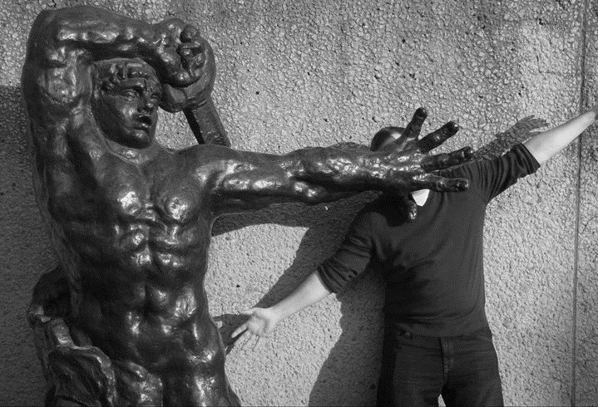


SeanKilleen
sjkilleen

Slide 3

“It’s free, right?”

Slide 4



Pricing
 |  |  | Total (Yearly)
10 projects | Free | $700 | $700
20 projects | $300 | $700 | $1000
60 Projects | $2000 | $2000 | $4000
Unlimited | $2000 | $5000 | $7000

Slide 5

HOW I LEARNED TO
STOP
WORRYING
AND
PAY FOR TOOLS

Slide 6
Build Configuration

Slide 7
Build Agent

Slide 8
Nuget Feed

Slide 9
Why a Separate Release Tool?

Slide 10
Project

Slide 11
OctoPack

Slide 12
Release

Slide 13
Environments

Slide 14
Targets

Slide 15
Build Lifecycle

Slide 16
Variable Sets

Slide 17
Step Templates

Slide 18
New: Channels

Slide 19
The Solution

Slide 20
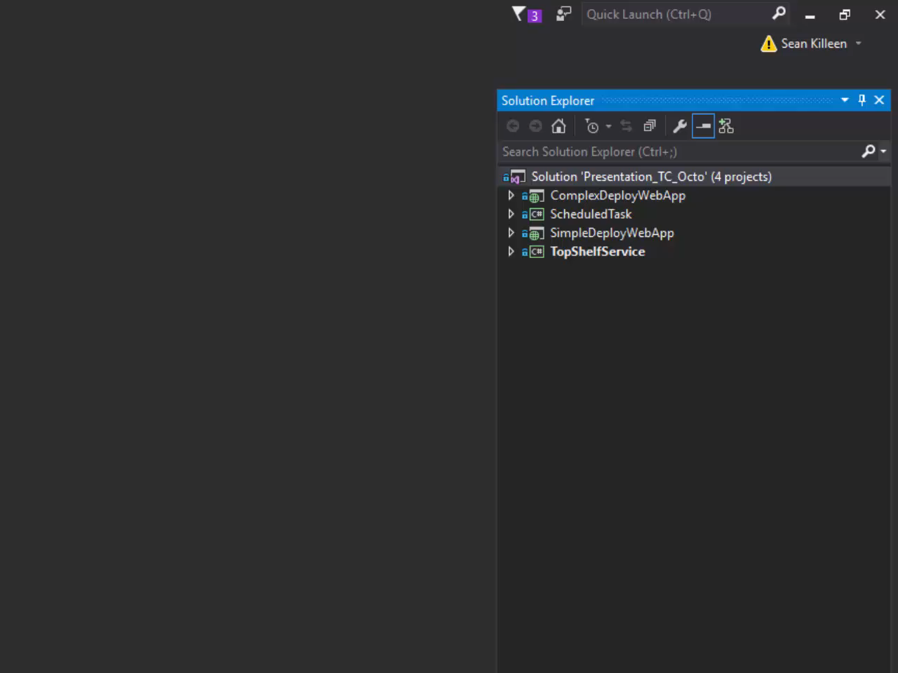
Video: Tour The Solution (01-01)

Slide 21
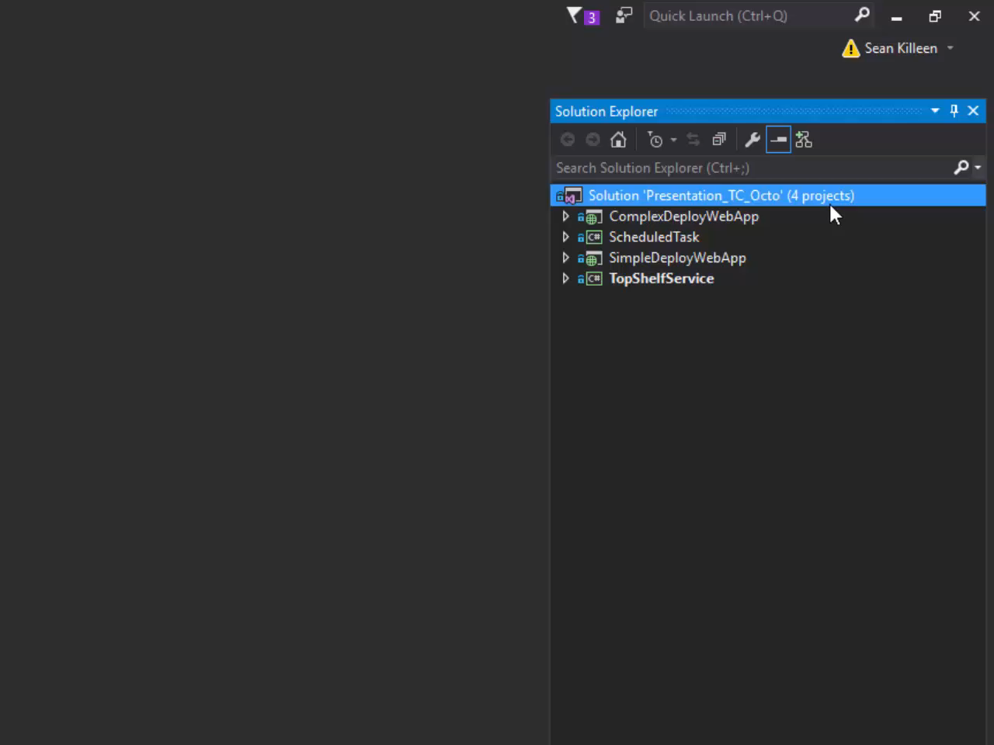
Video: Tour The Solution (01-02)

Slide 22
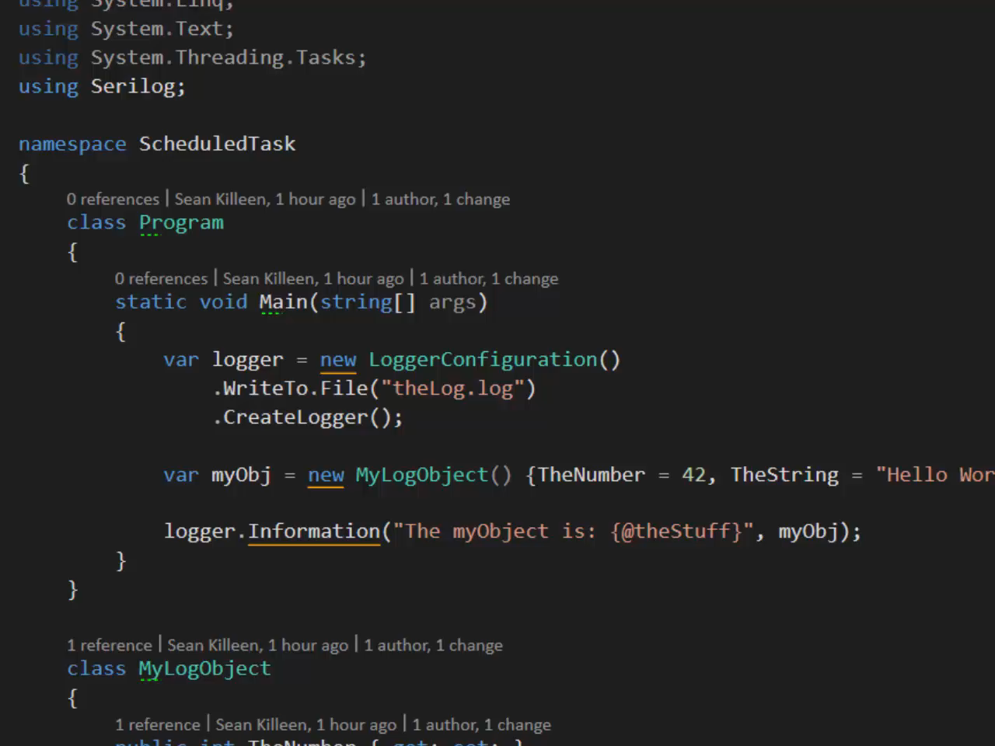
Video: Tour The Solution (01-03)

Slide 23
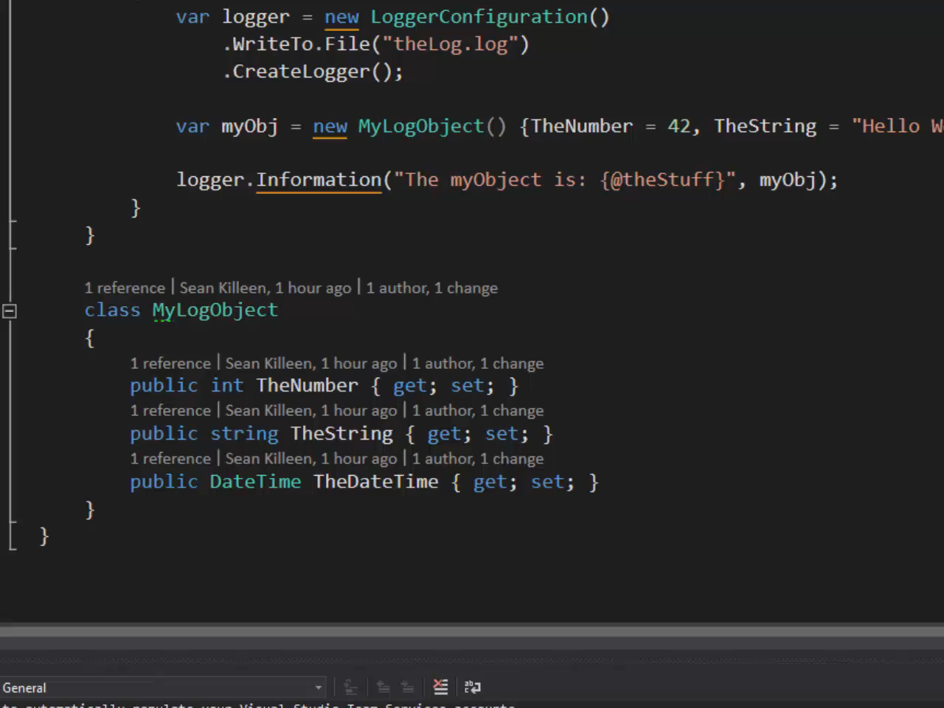
Video: Tour The Solution (01-04)

Slide 24
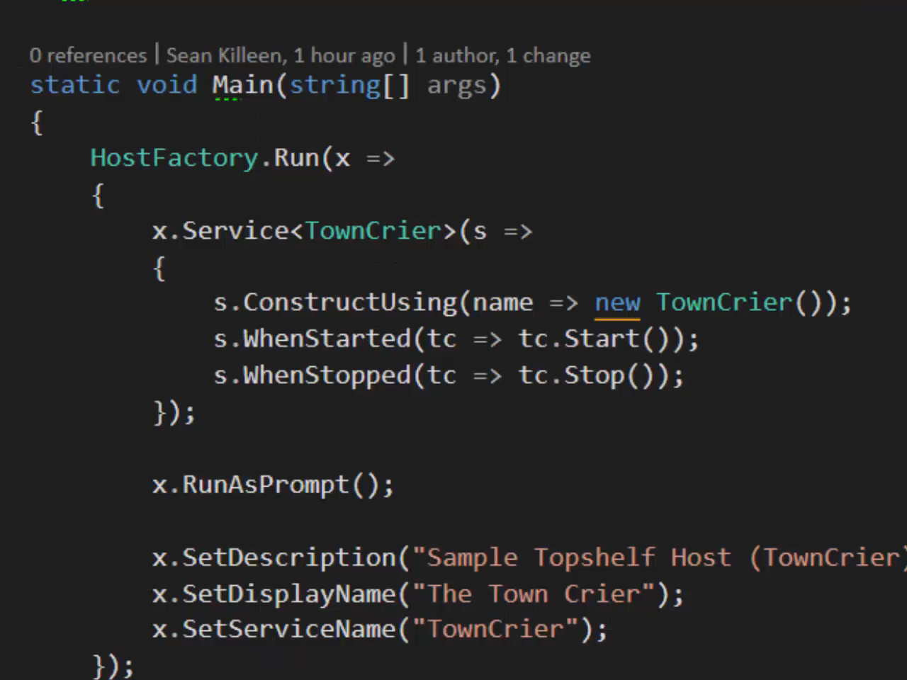
Video: Tour The Solution (01-05)

Slide 25
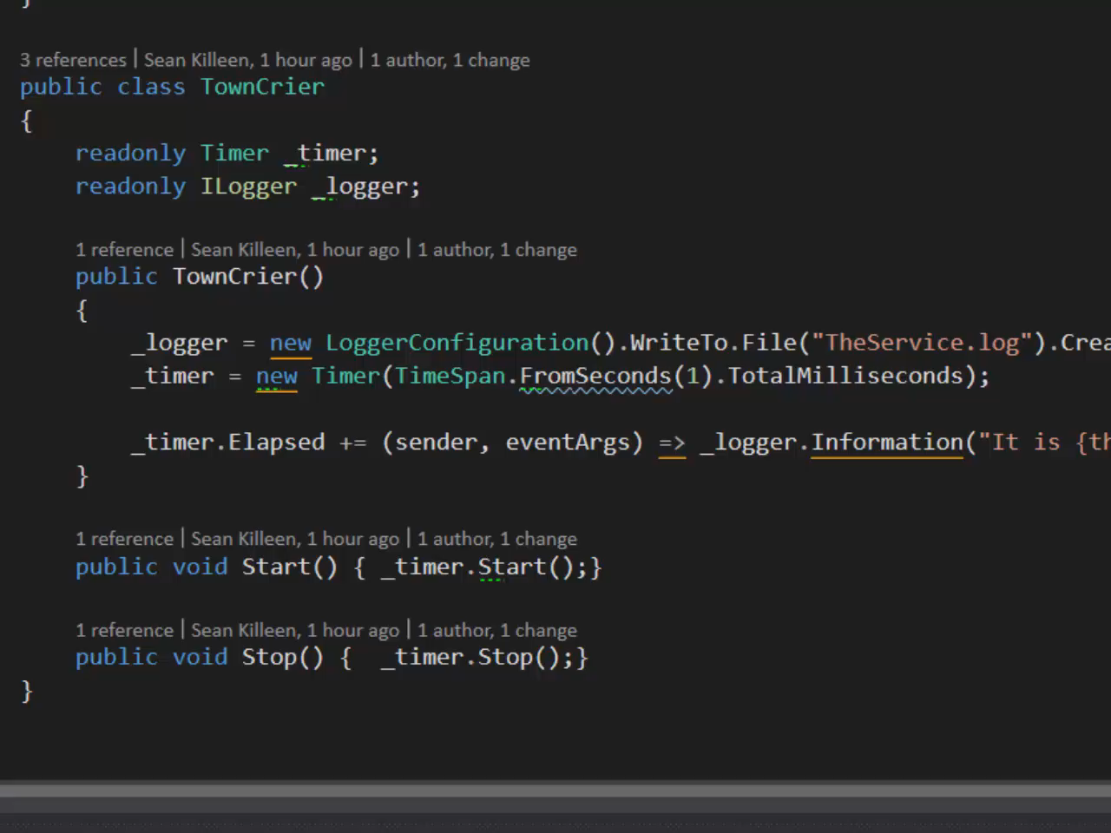
Video: Tour The Solution (01-06)

Slide 26
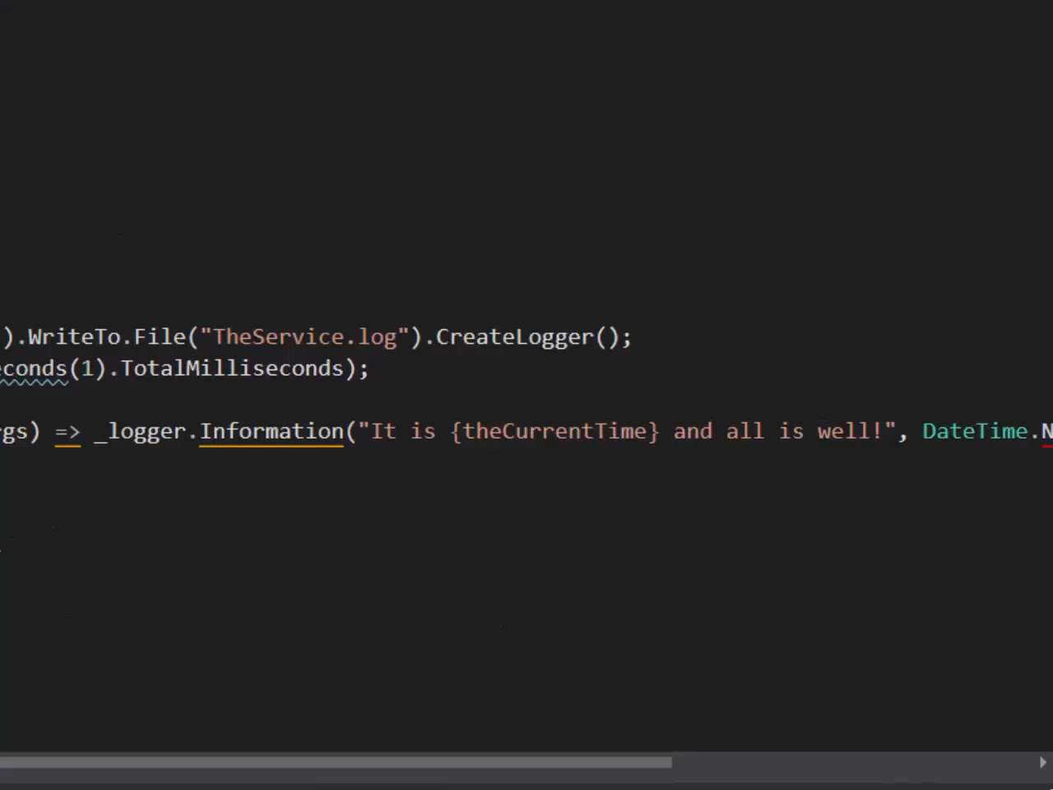
Video: Tour The Solution (01-07)

Slide 27
Add Tests

Slide 28
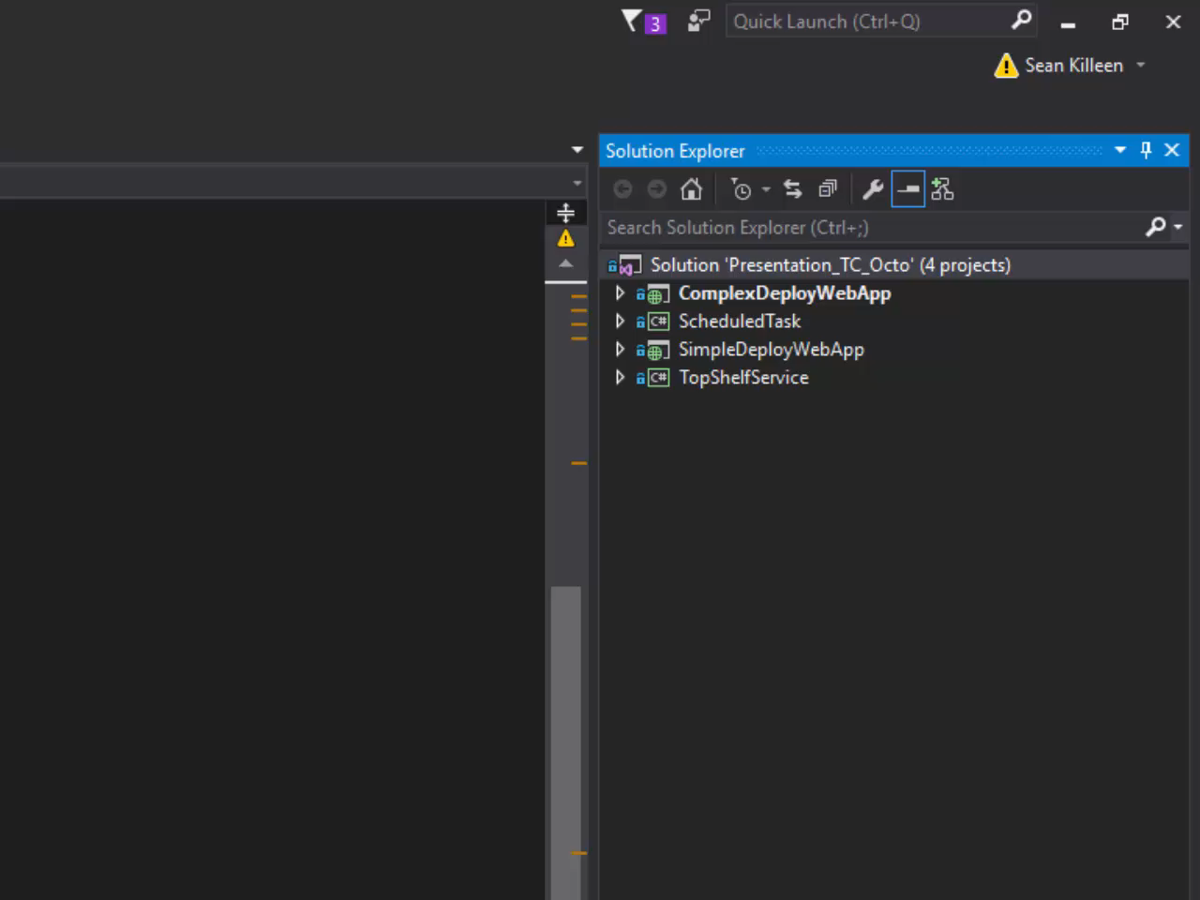
Video: Add A Test (02)

Slide 29
TeamCity Install

Slide 30
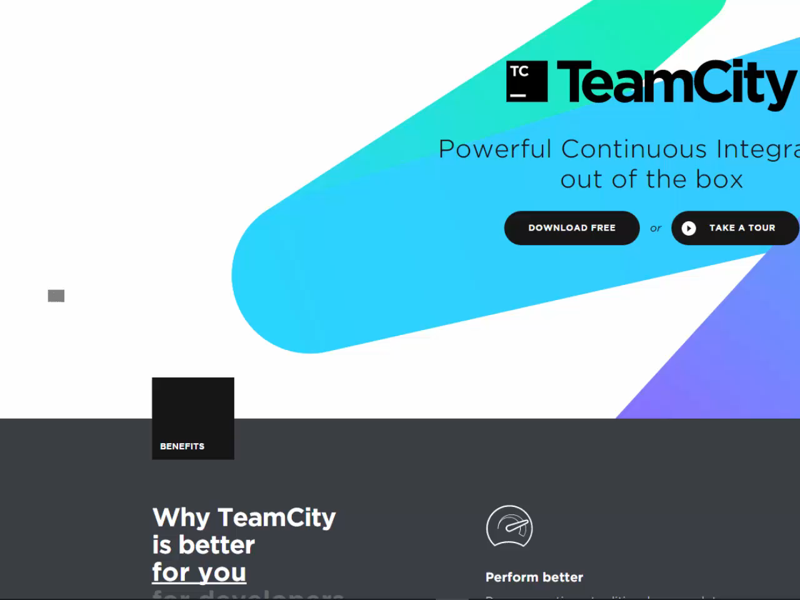
Video: TeamCity Install (03-01)

Slide 31
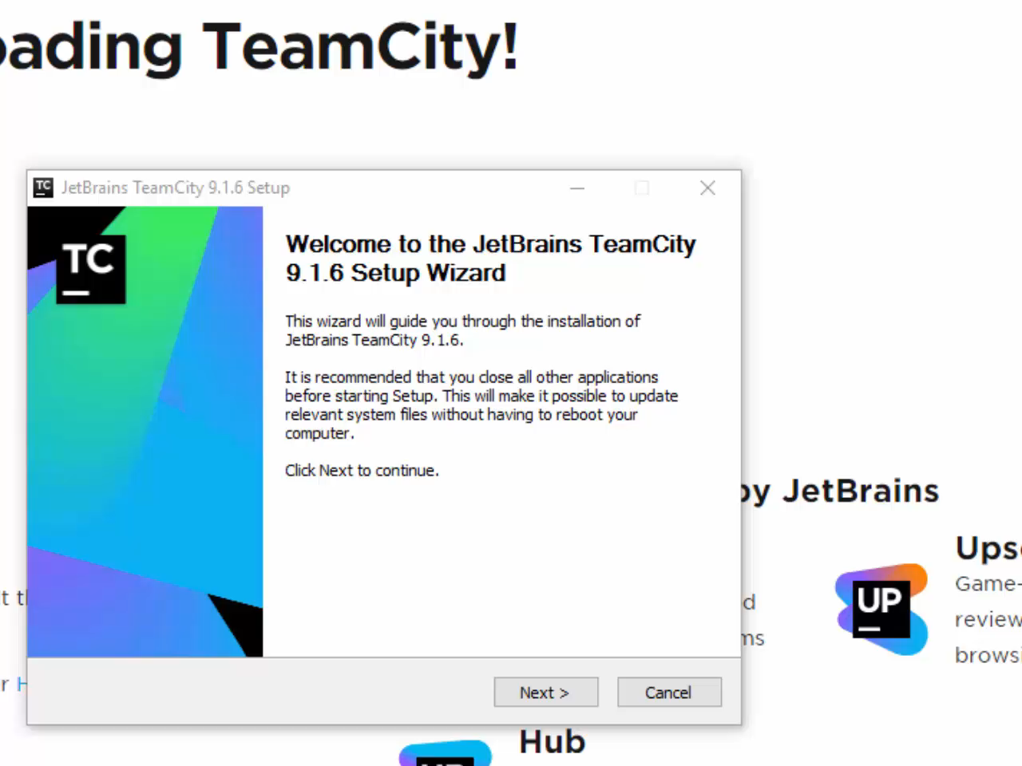
Video: TeamCity First Run (04-01)

Slide 32
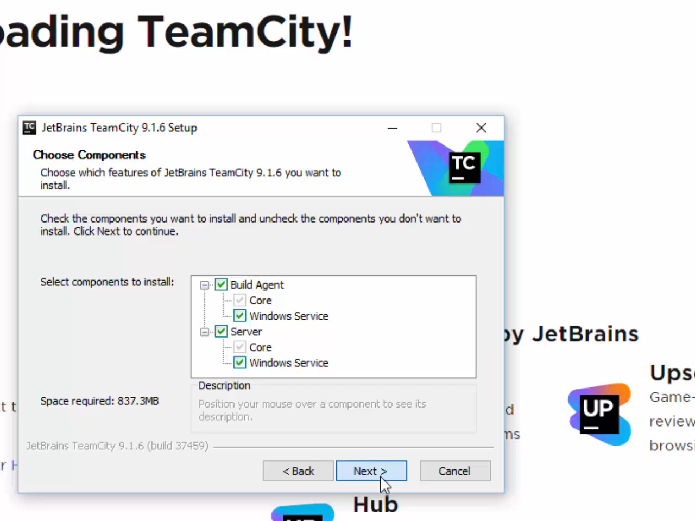
Video: TeamCity First Run (04-02)

Slide 33
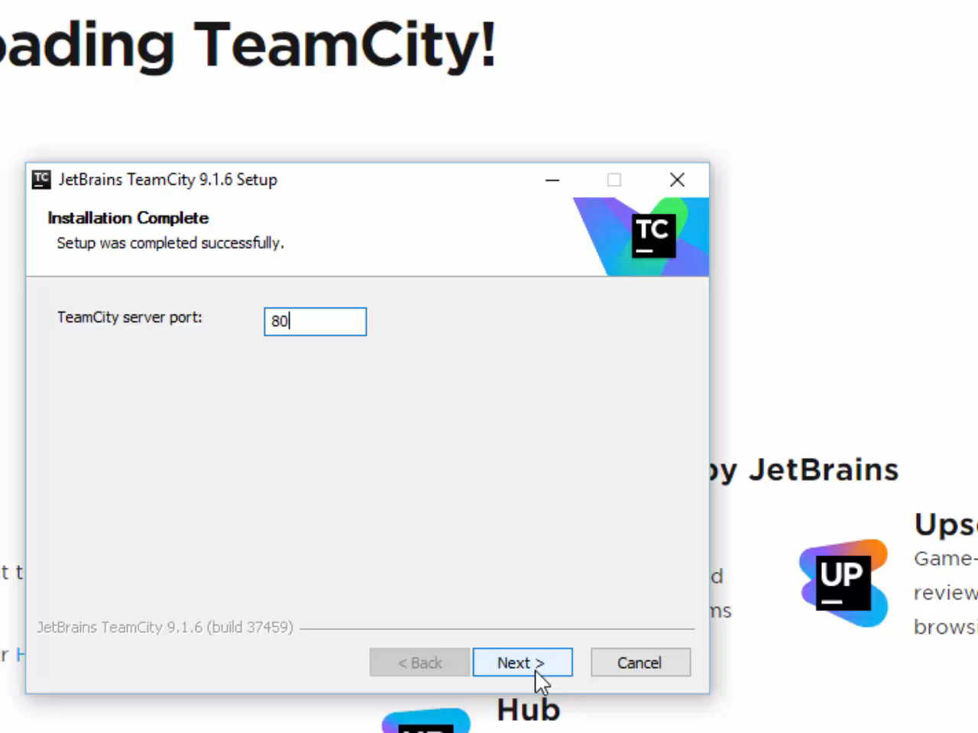
Video: TeamCity First Run (04-03)

Slide 34
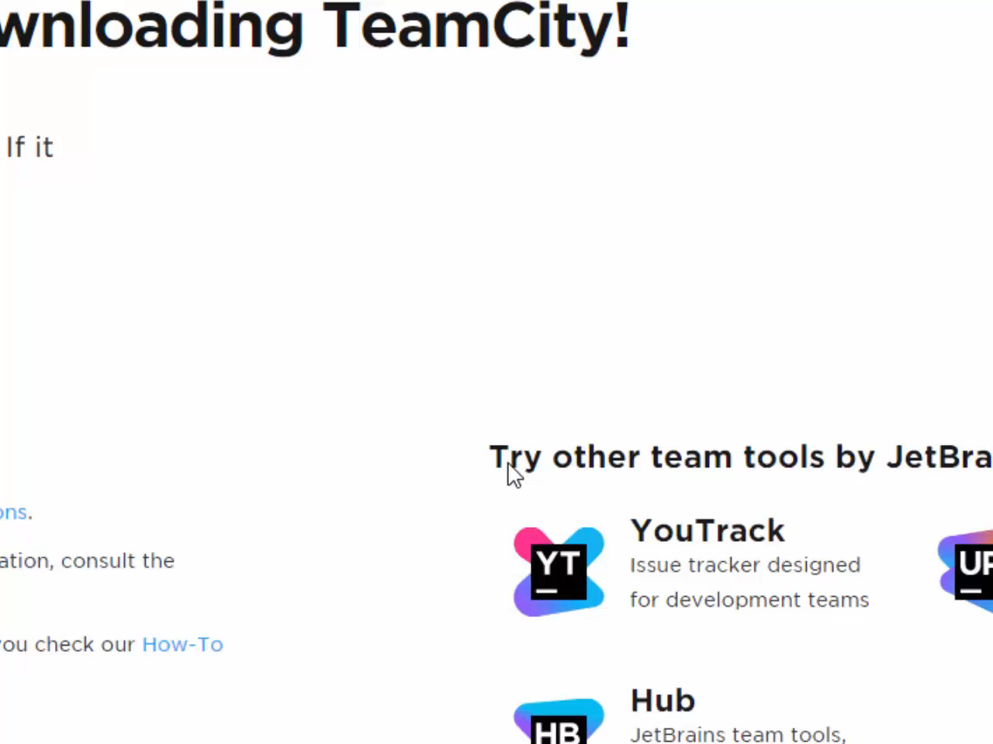
Video: TeamCity First Run (04-04)

Slide 35
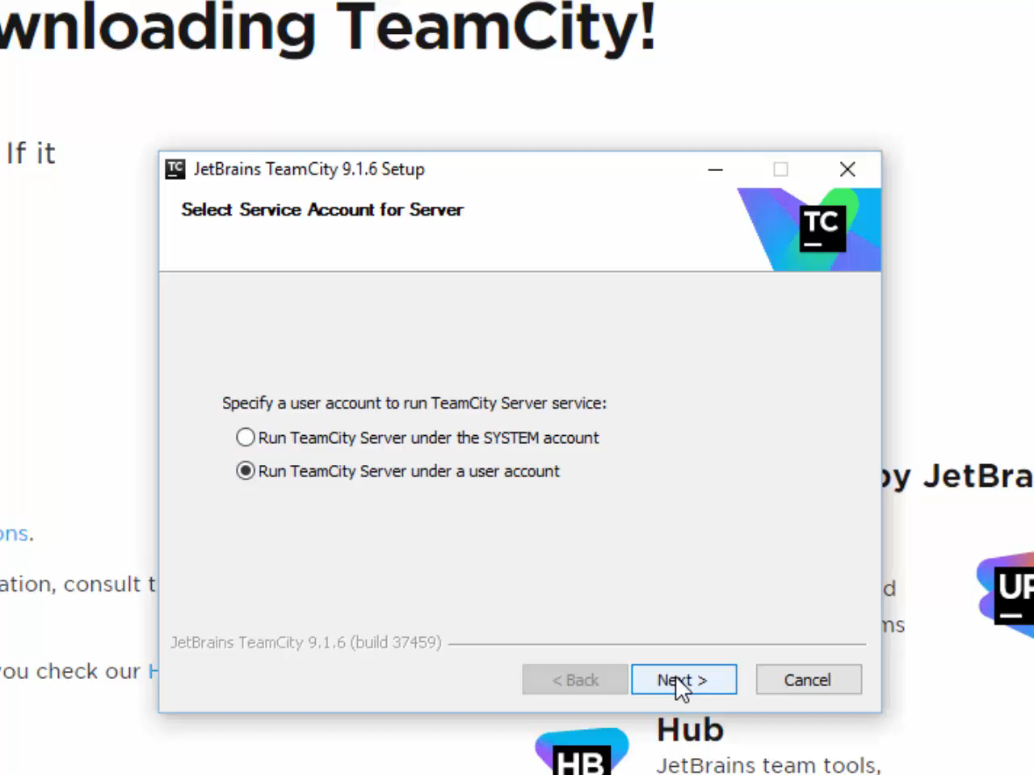
Video: TeamCity First Run (04-05)

Slide 36
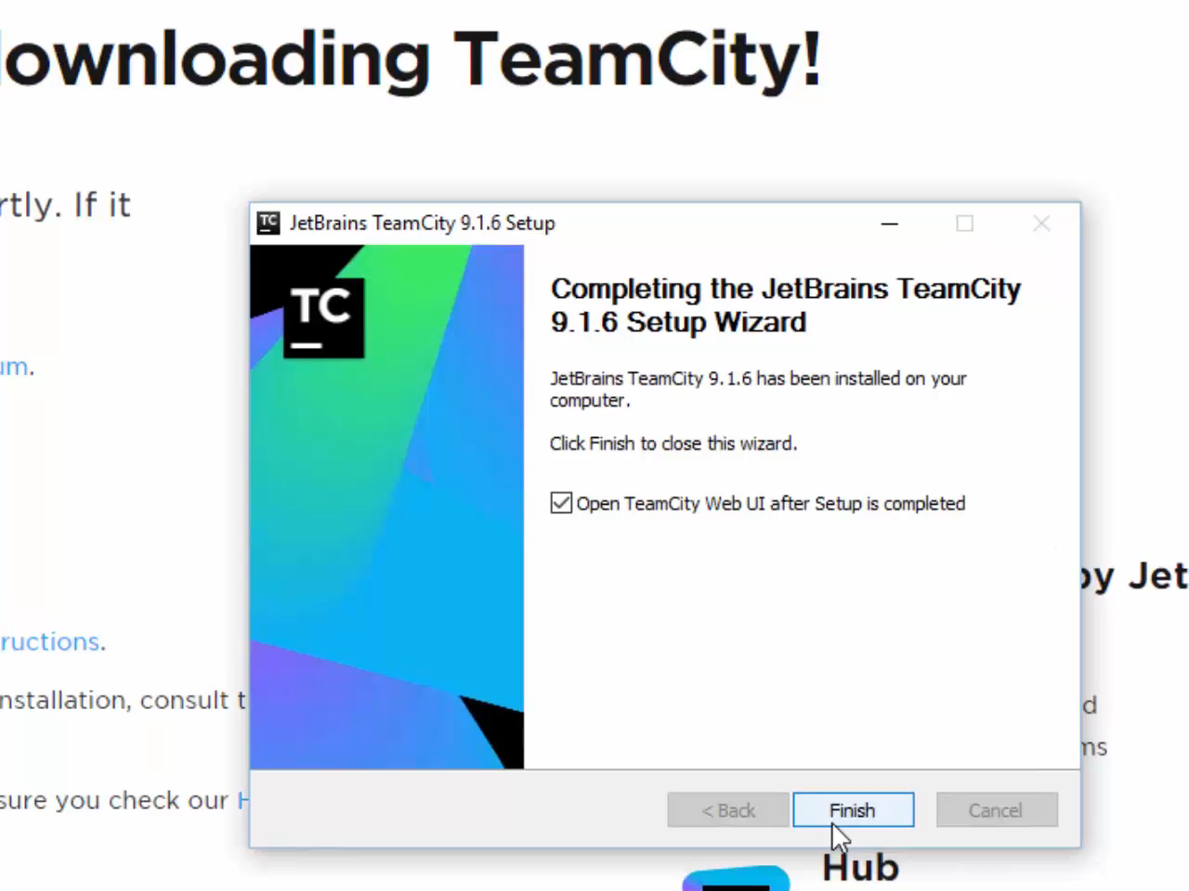
Video: TeamCity First Run (04-06)

Slide 37
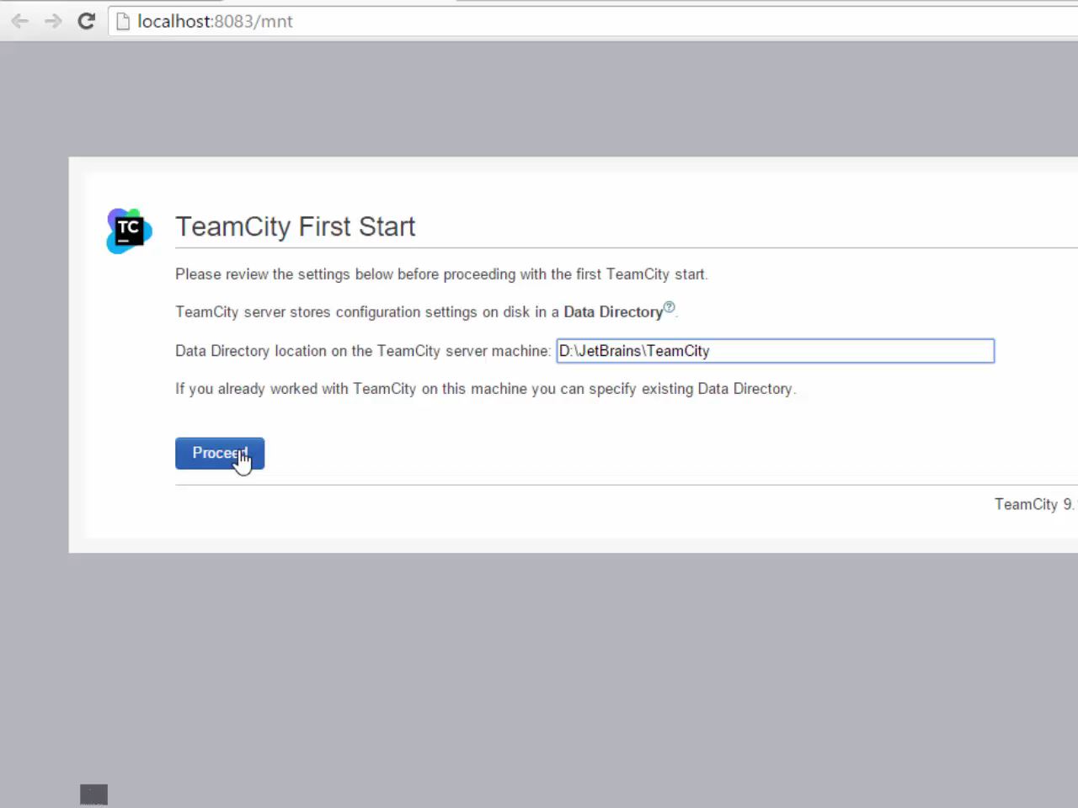
Video: TeamCity First Run (04-07)

Slide 38
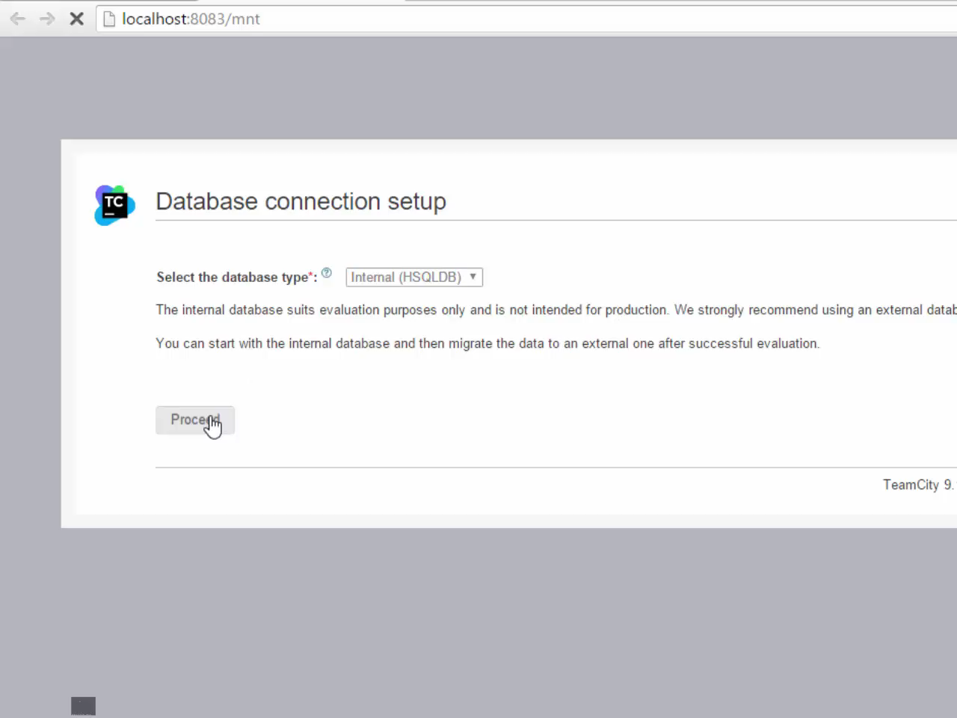
Video: TeamCity First Run (04-08)

Slide 39
Auth & NuGet

Slide 40
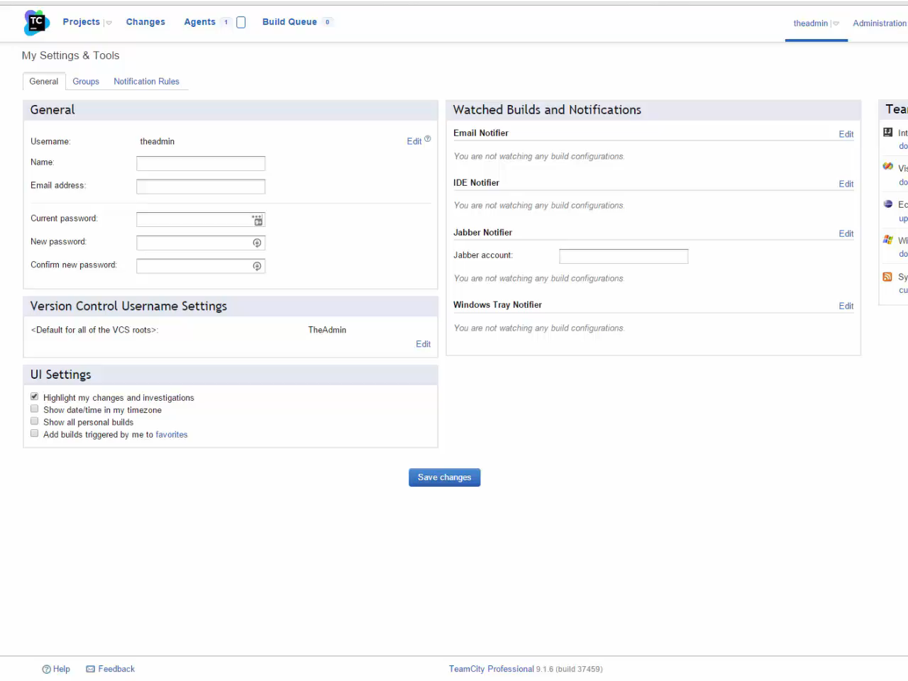
Video: Auth & Nuget (05-01)

Slide 41
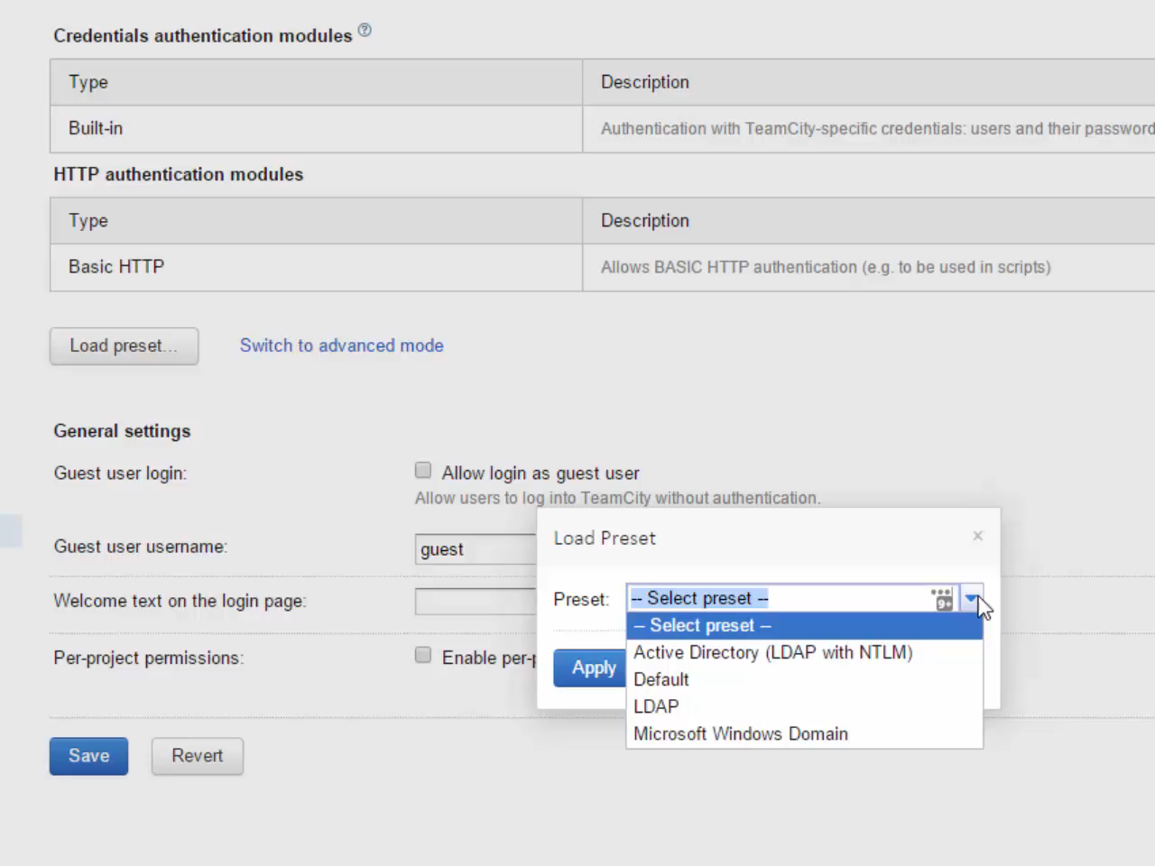
Video: Auth & Nuget (05-02)

Slide 42
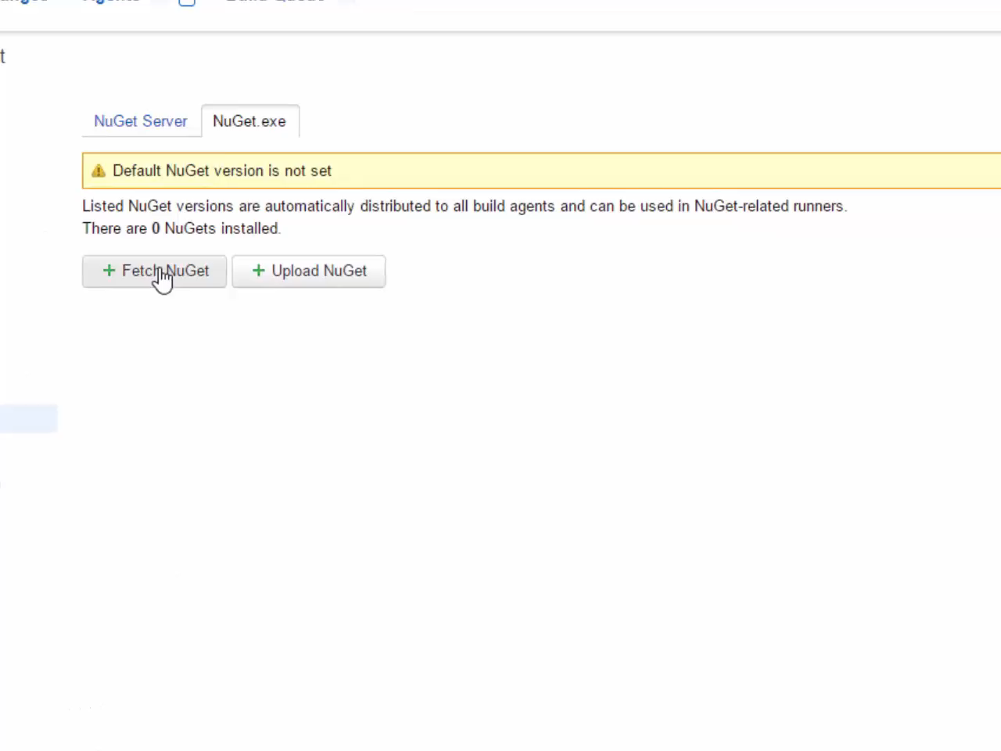
Video: Auth & Nuget (05-03)

Slide 43
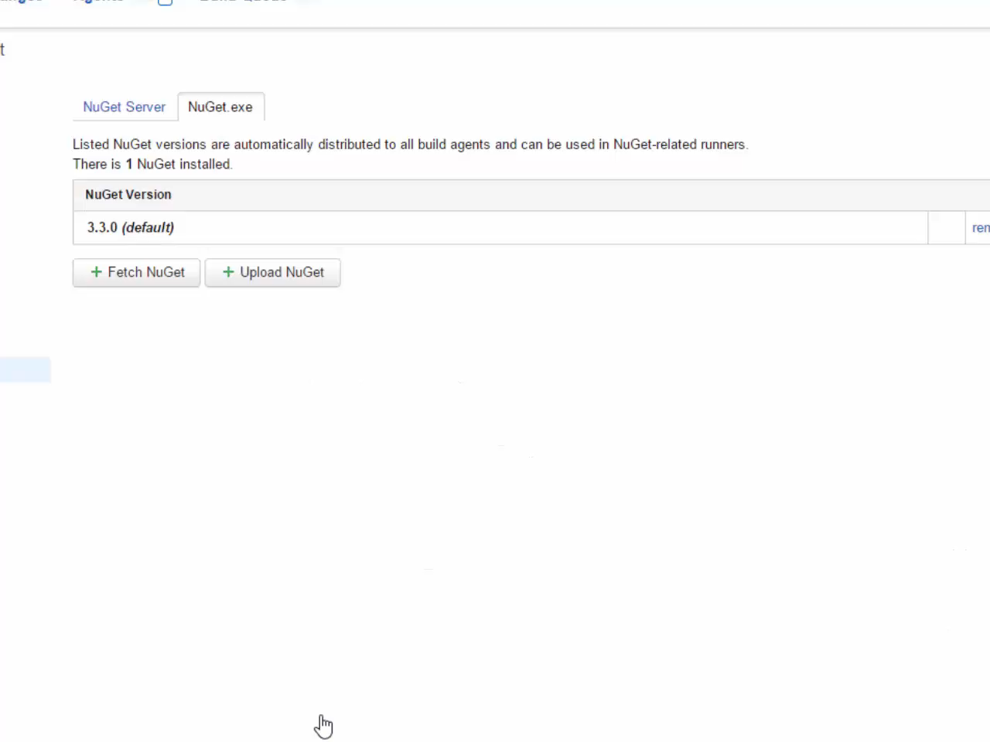
Video: Auth & Nuget (05-04)

Slide 44
1st Build Config

Slide 45
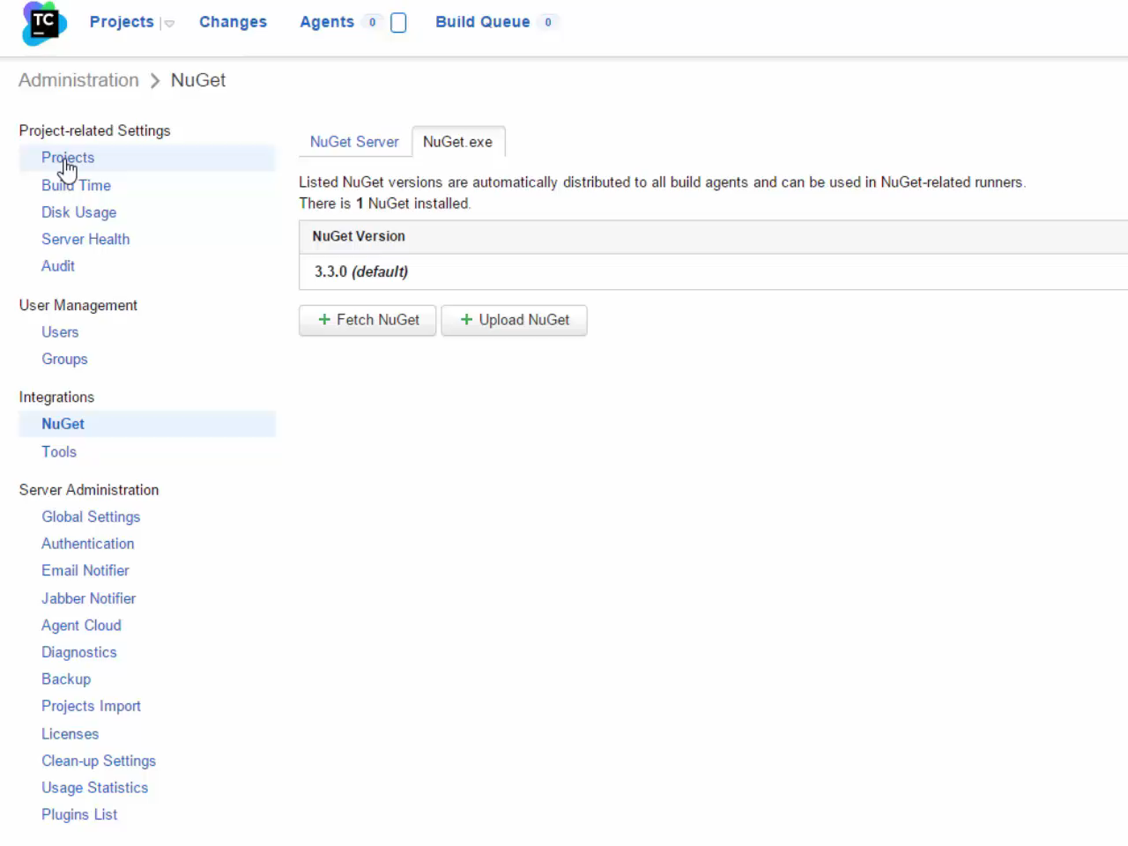
Video: Build Config (06-01)

Slide 46
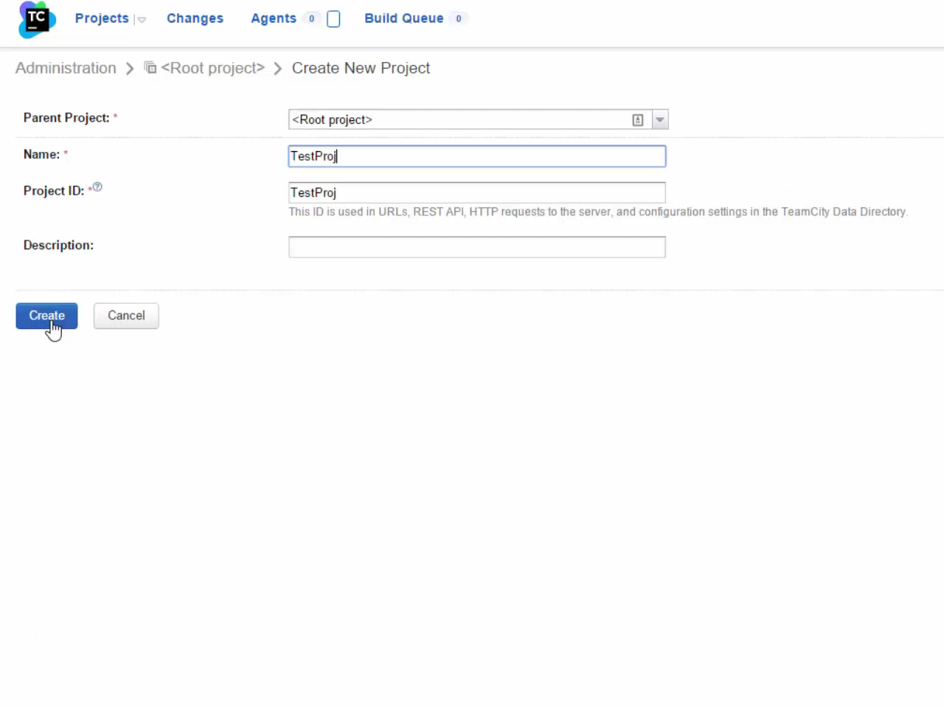
Video: Build Config (06-02)

Slide 47
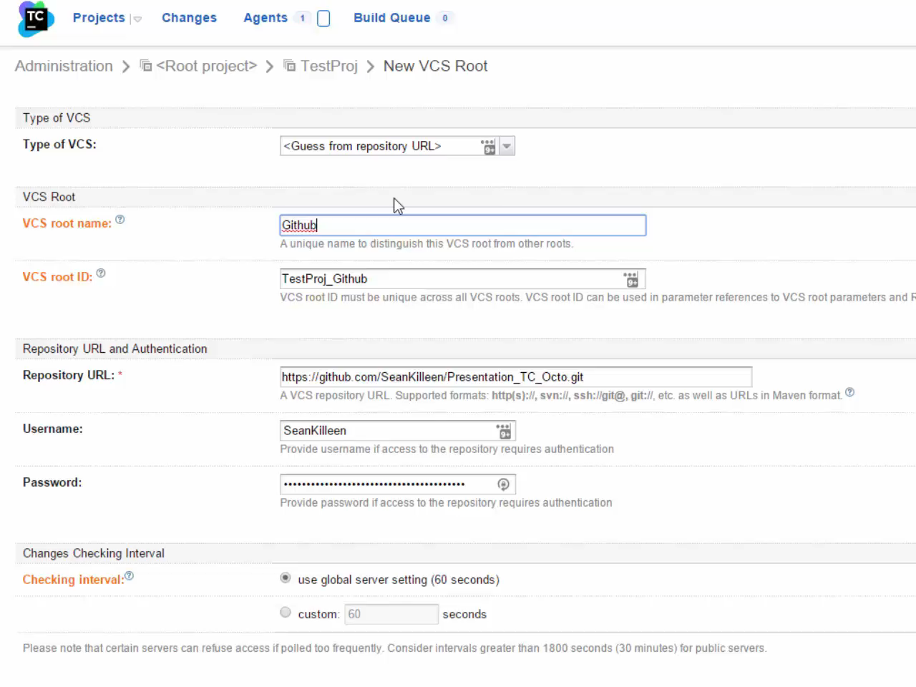
Video: Build Config (06-03)

Slide 48
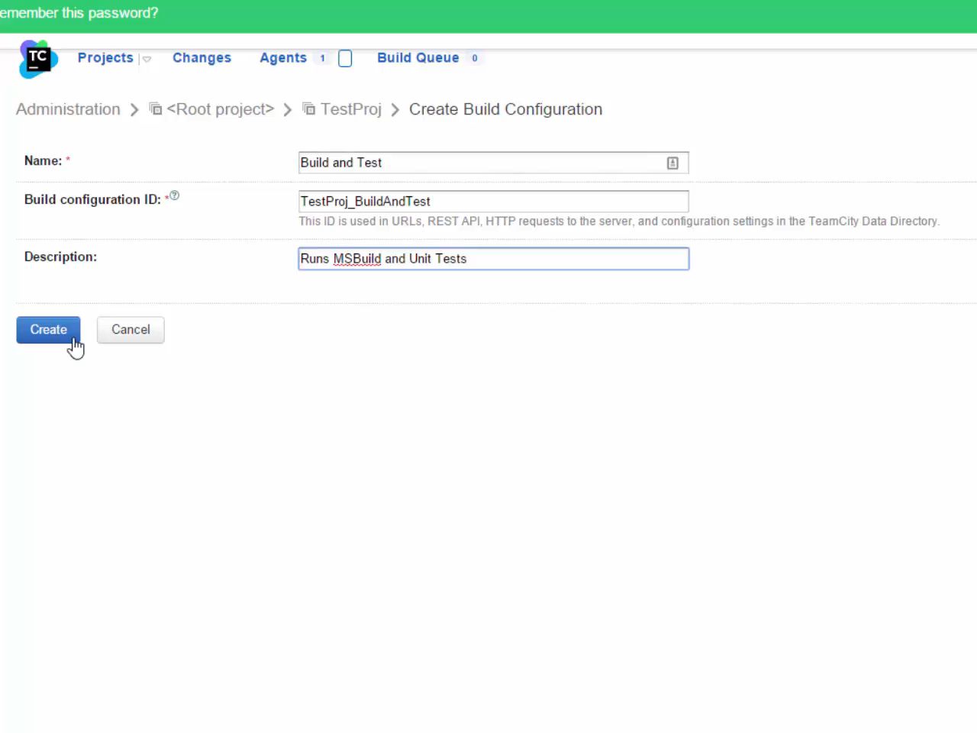
Video: Build Config (06-04)

Slide 49
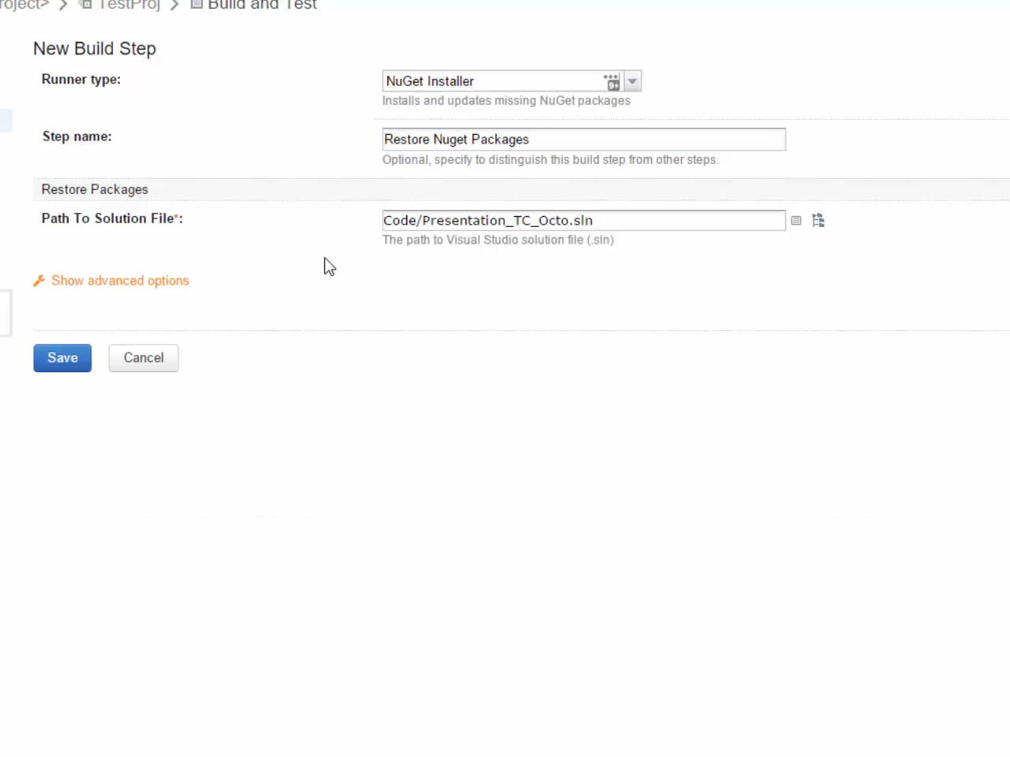
Video: Build Config (06-05)

Slide 50
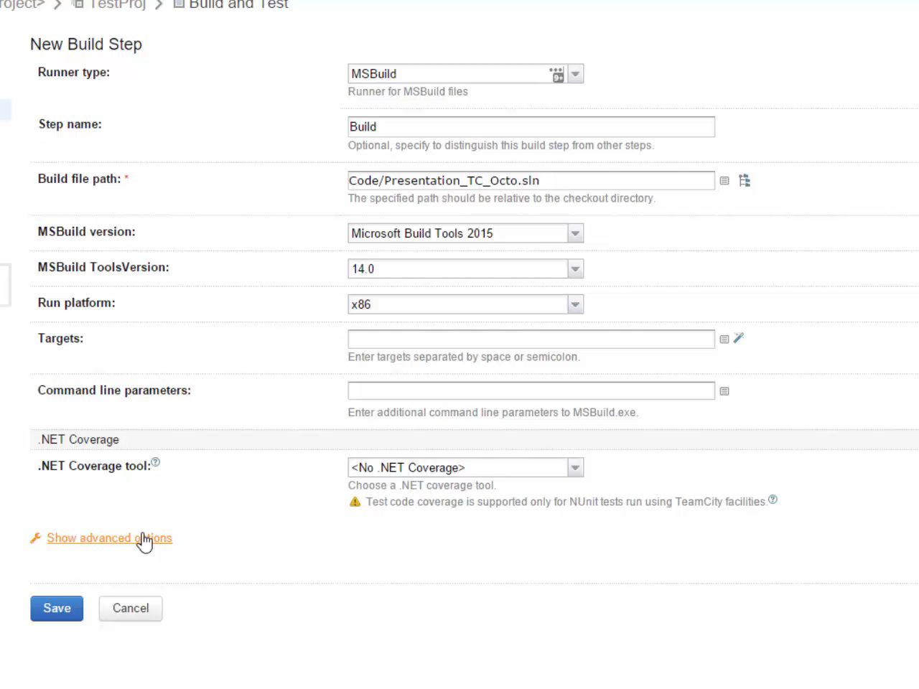
Video: Build Config (06-06)

Slide 51
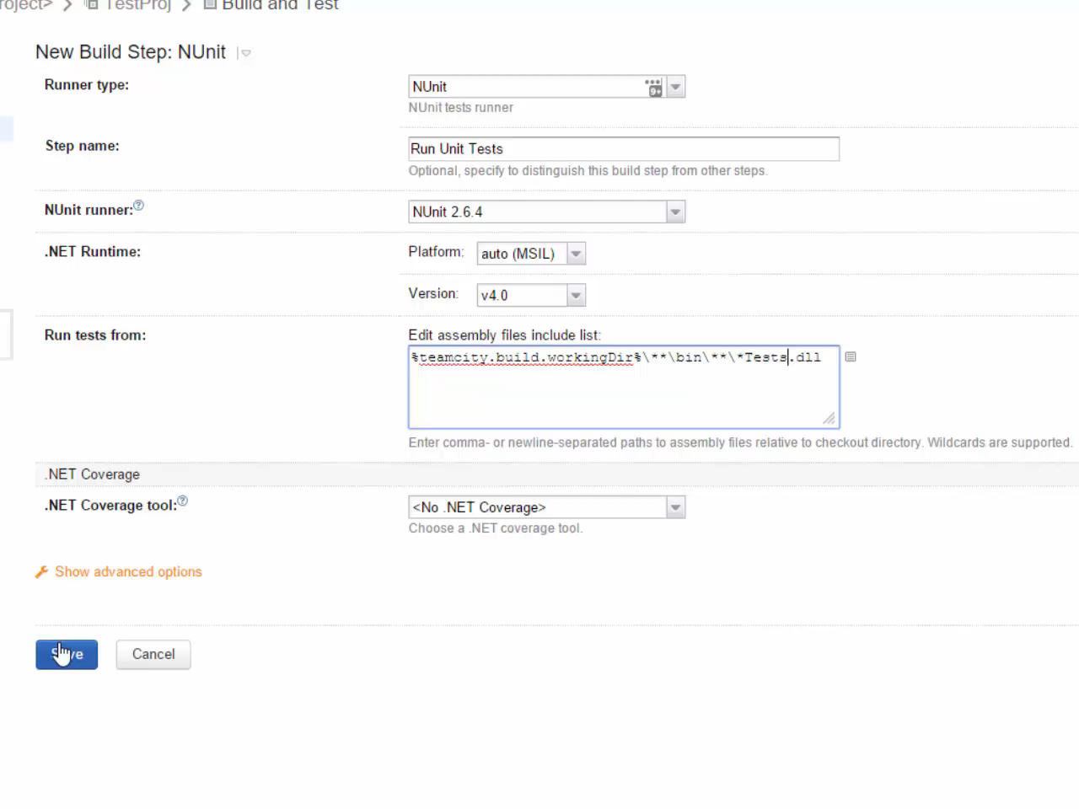
Video: Build Config (06-07)

Slide 52
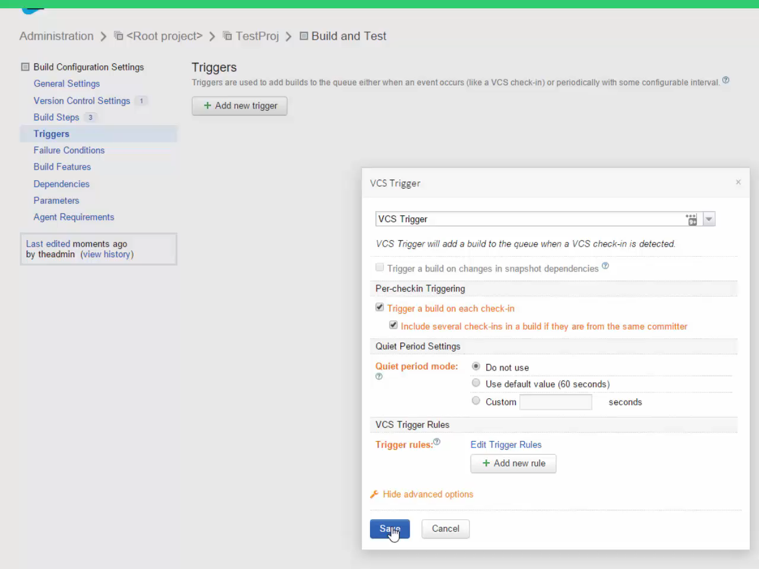
Video: Build Config (06-08)

Slide 53
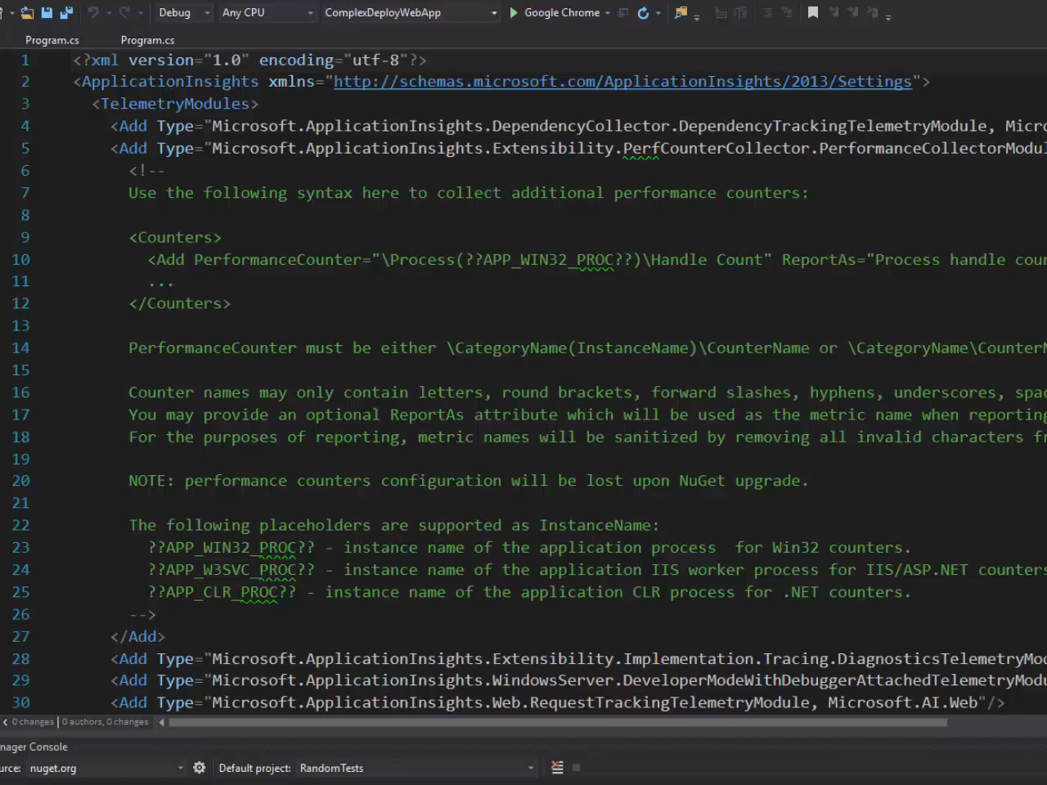
Video: Build Config (06-09)

Slide 54
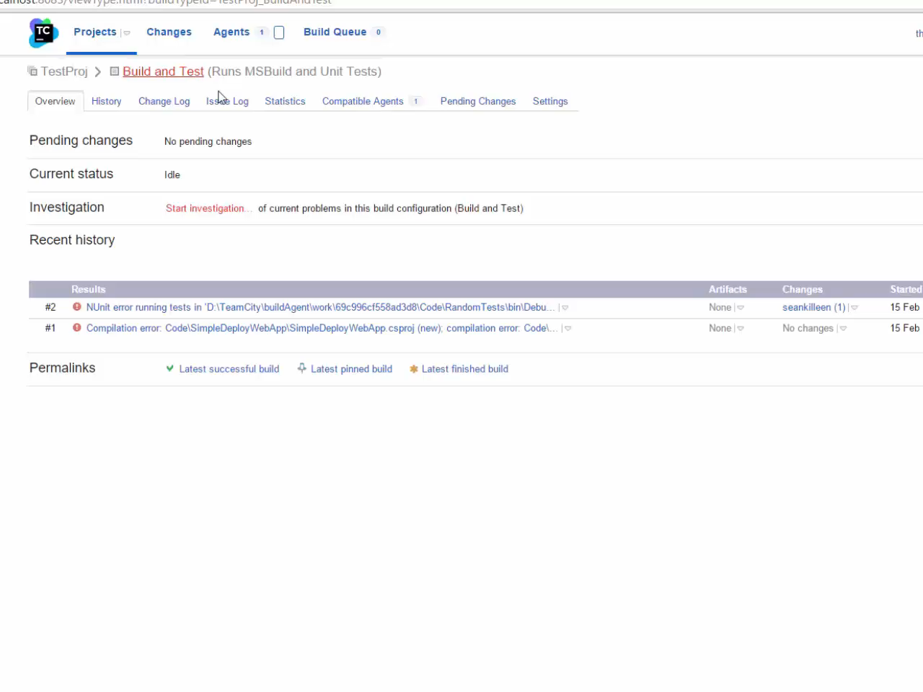
Video: Build Config (06-10)

Slide 55
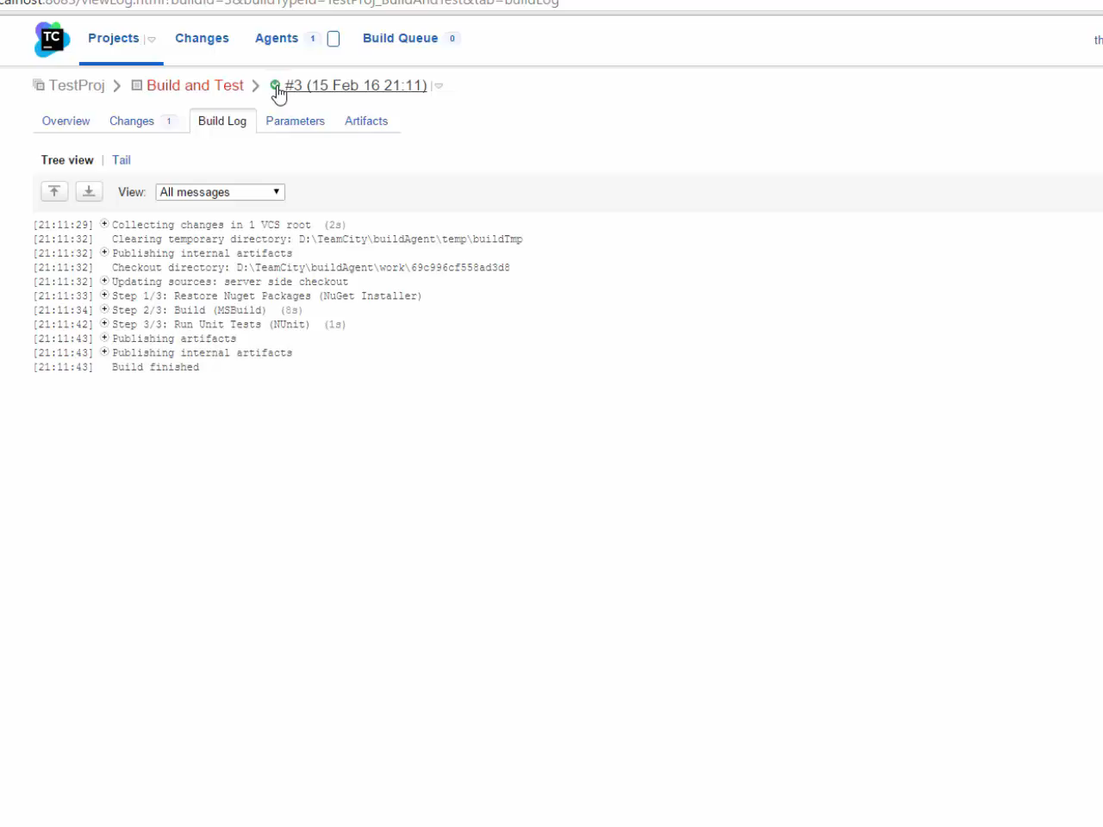
Video: Build Config (06-11)

Slide 56
Build all PRs

Slide 57
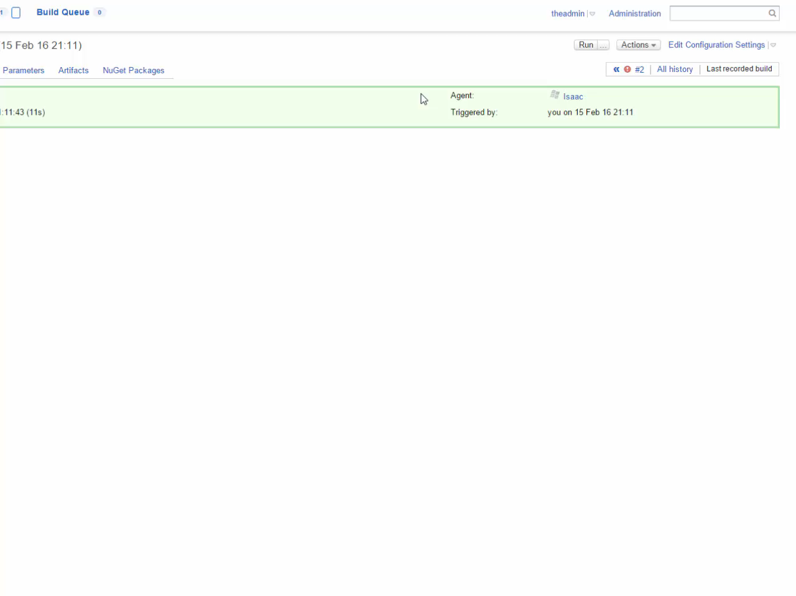
Video: Building all PRs (07-01)

Slide 58
Octopus Install

Slide 59
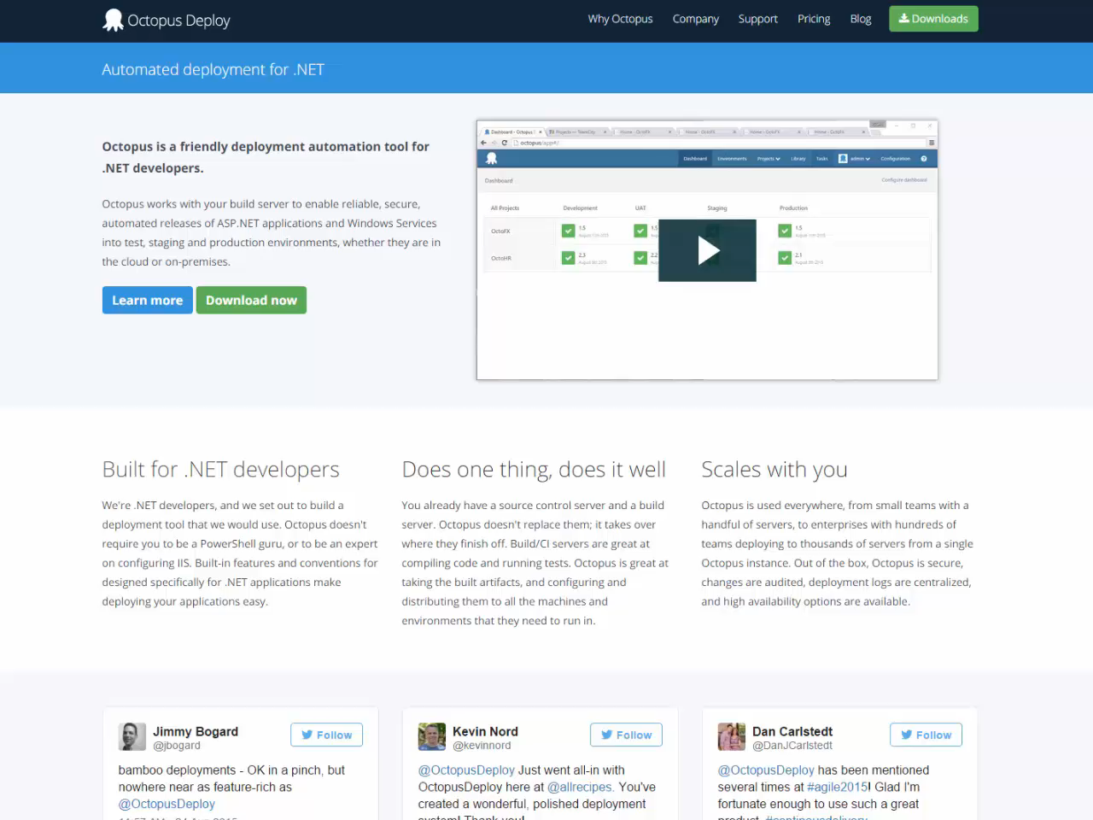
Video: Installation (08-01)

Slide 60
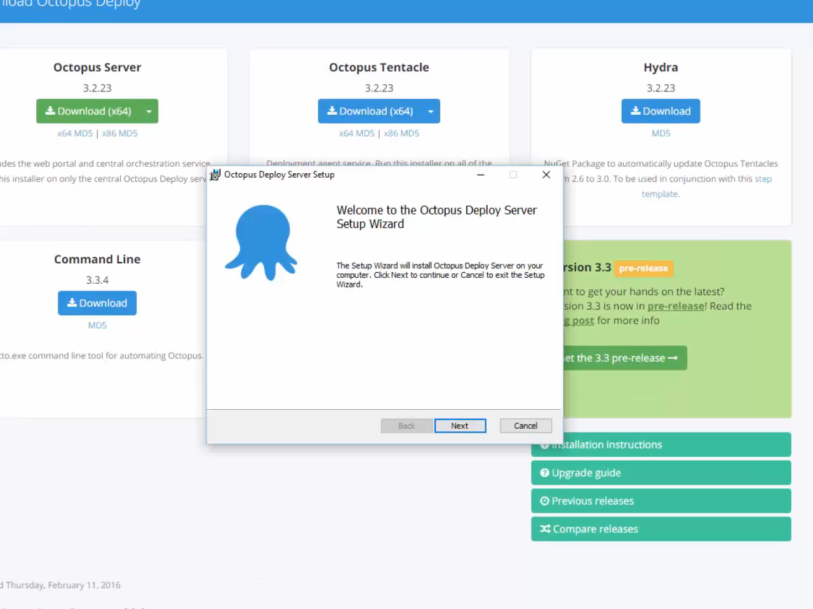
Video: Installation (08-02)

Slide 61
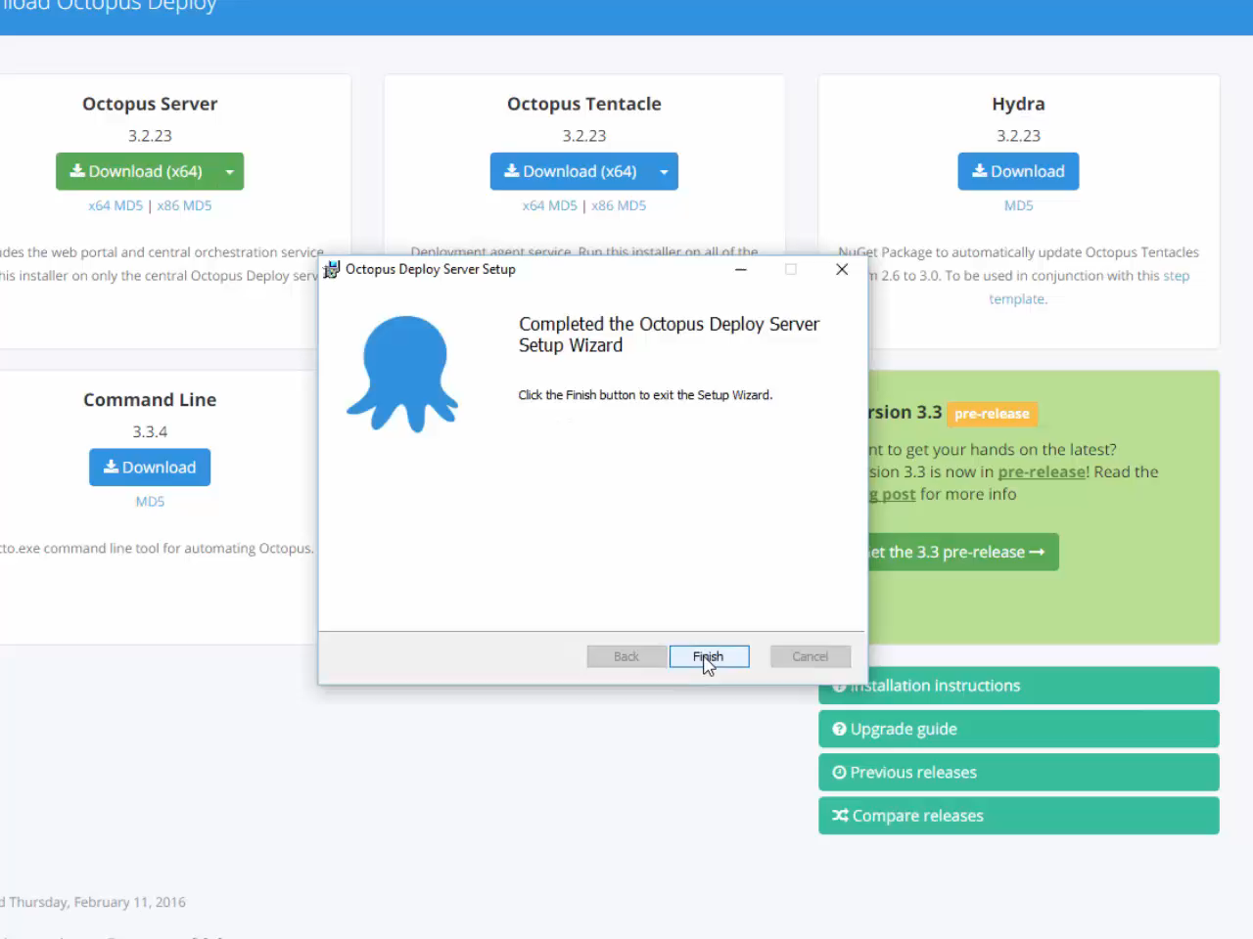
Video: Installation (08-03)

Slide 62
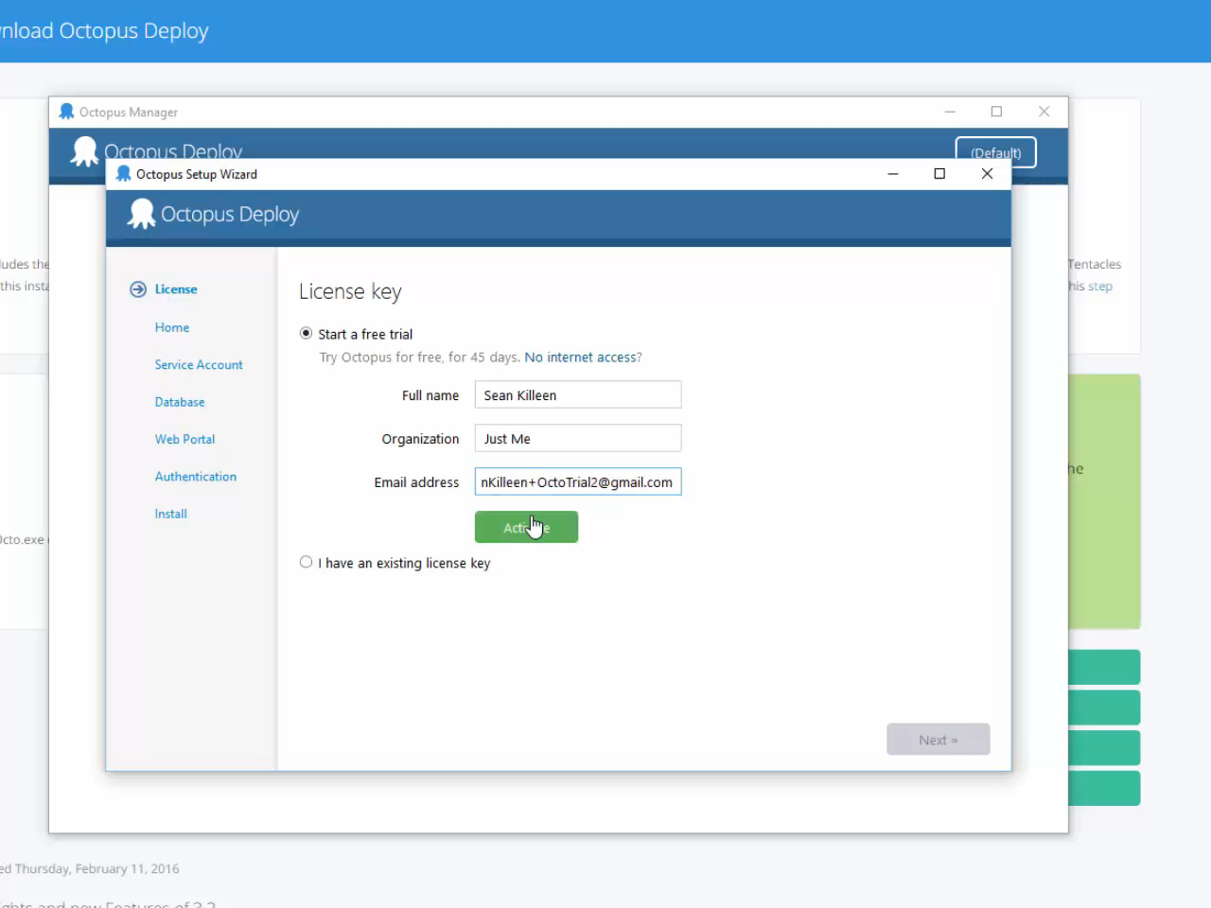
Video: Installation (08-04)

Slide 63
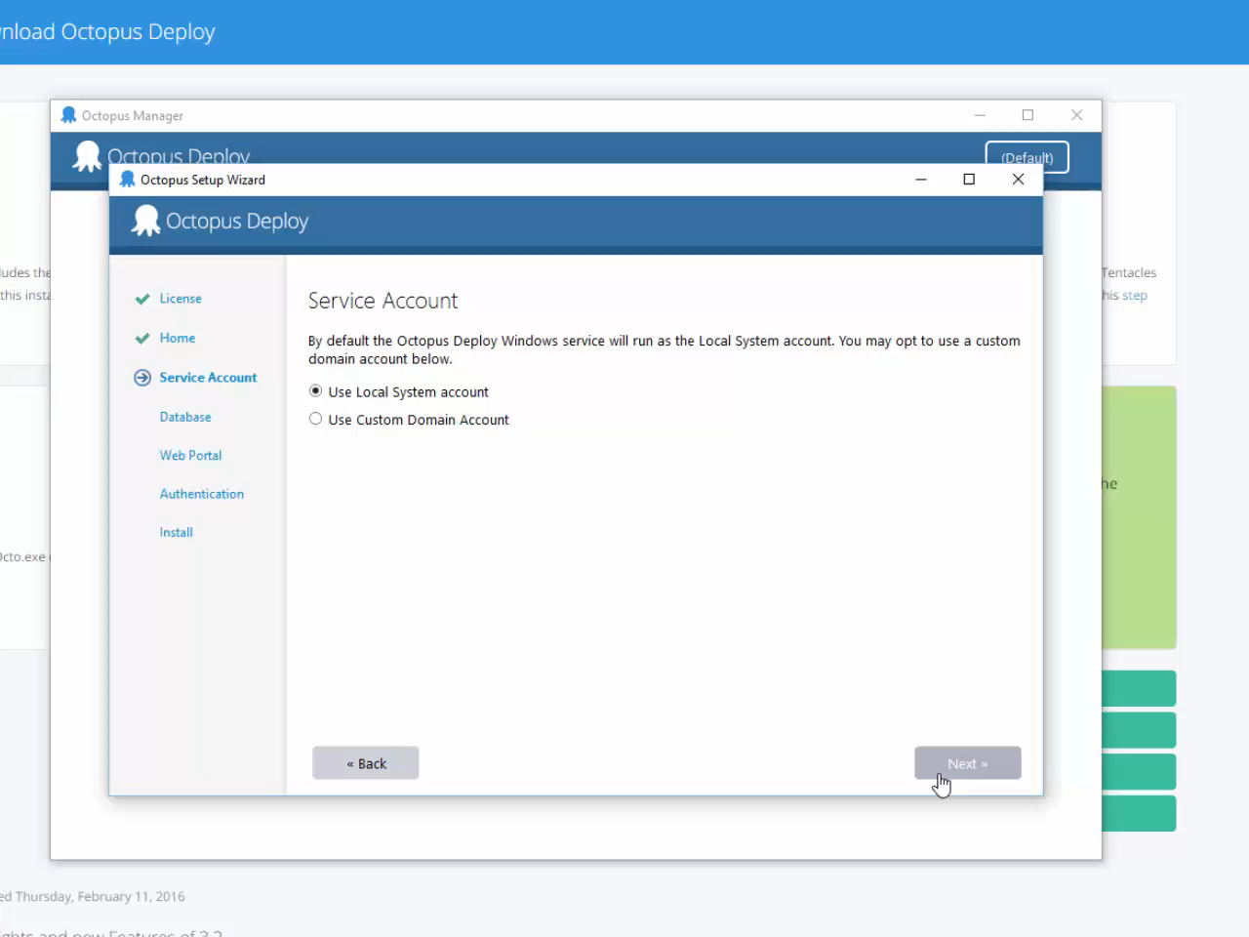
Video: Installation (08-05)

Slide 64
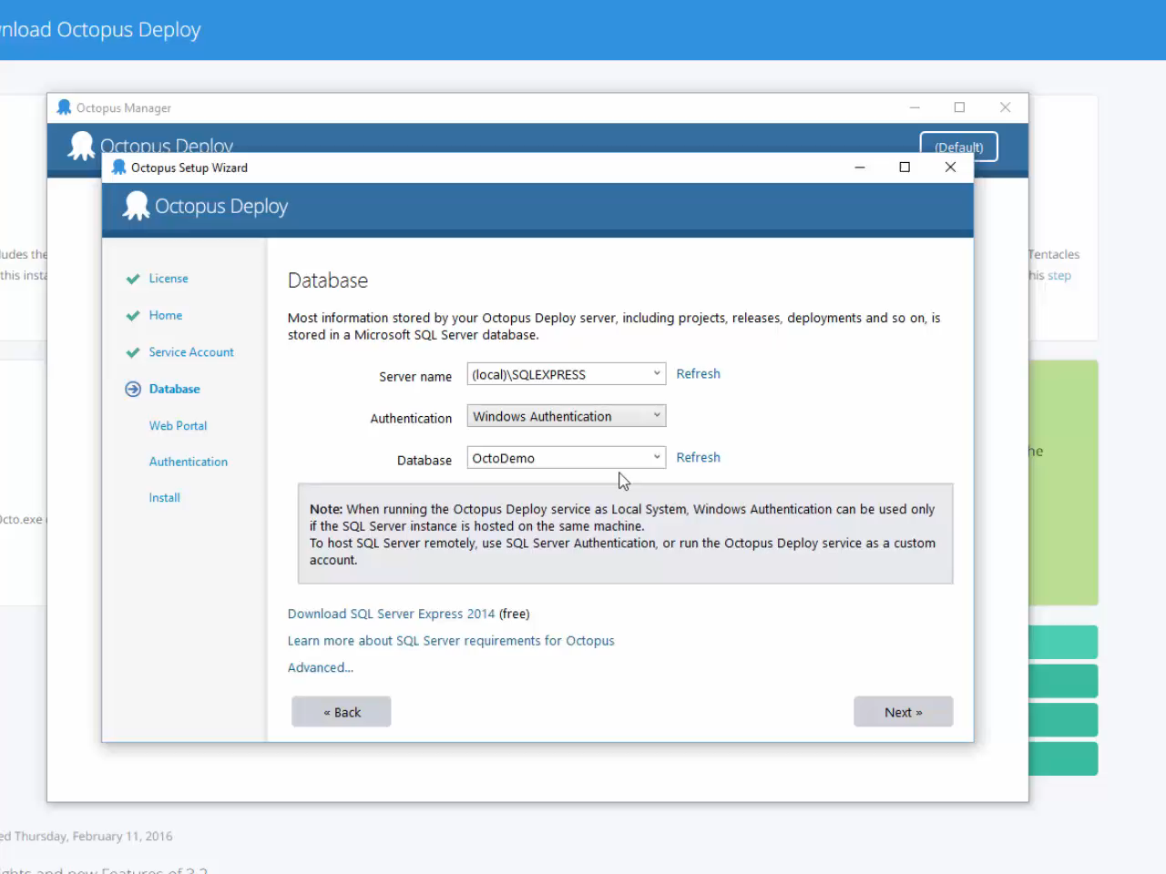
Video: Installation (08-06)

Slide 65
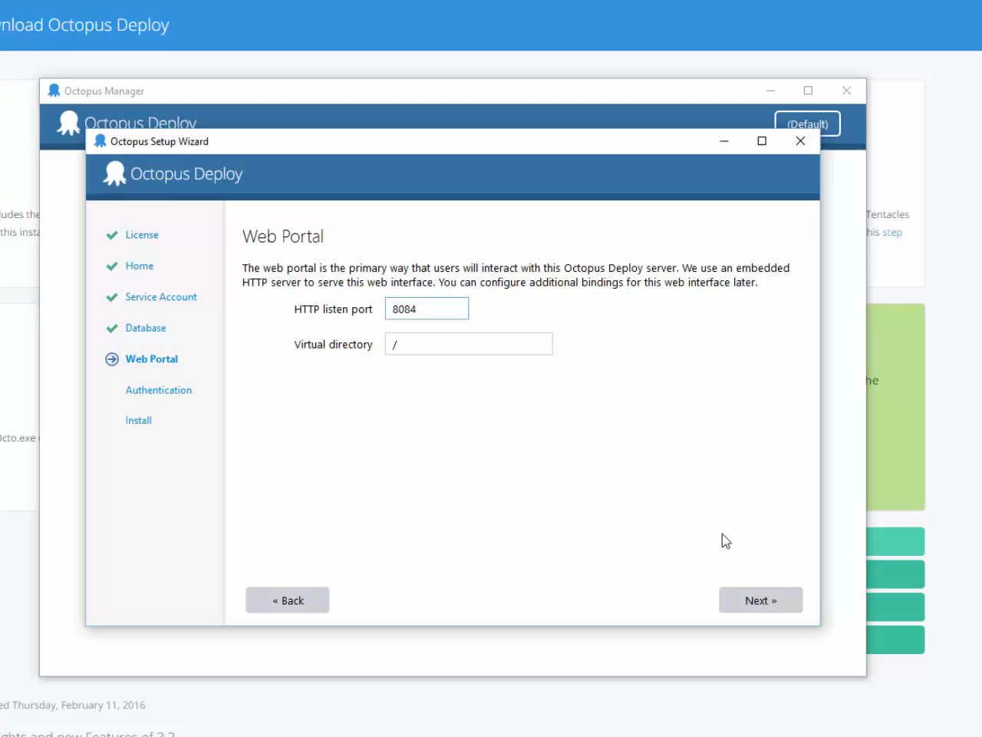
Video: Installation (08-07)

Slide 66
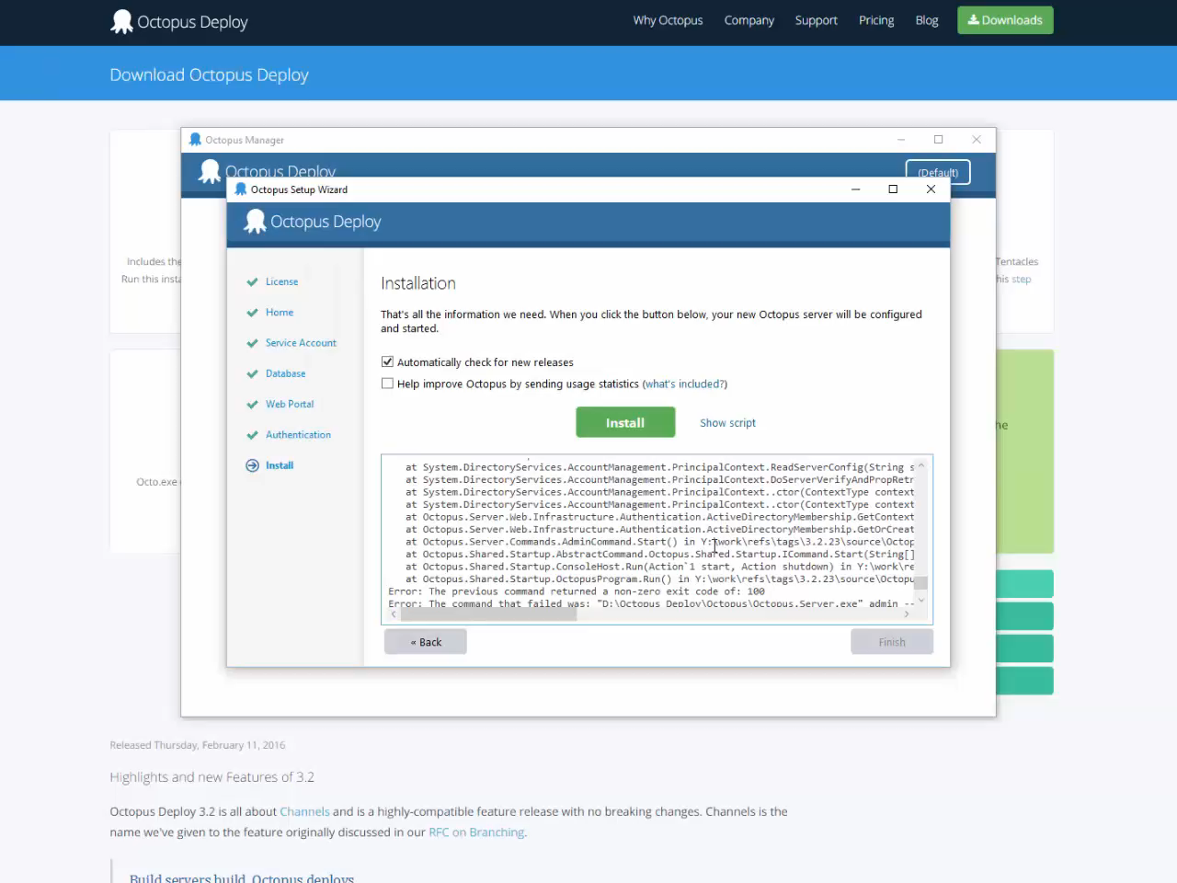
Video: Installation (08-08)

Slide 67
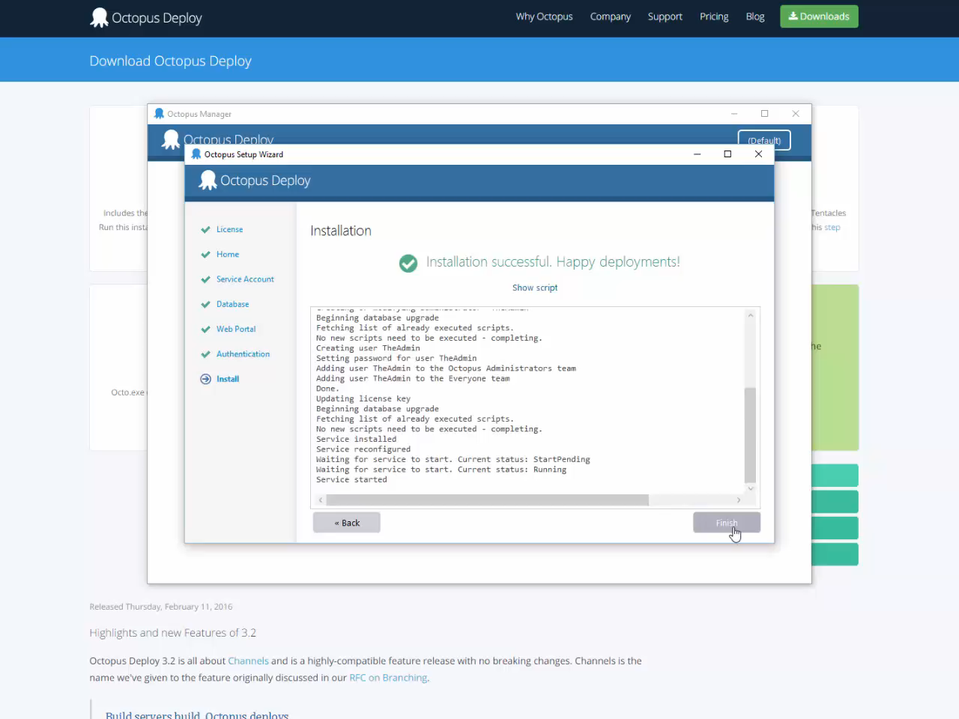
Video: Installation (08-09)

Slide 68
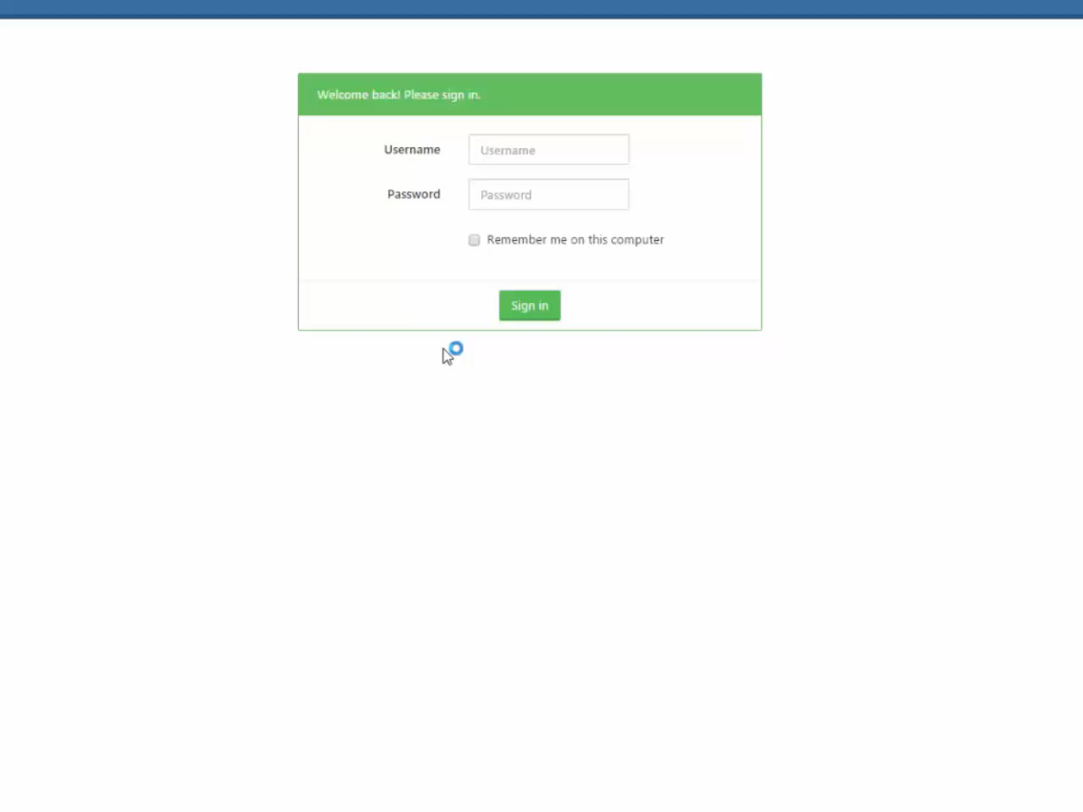
Video: Installation (08-10)

Slide 69
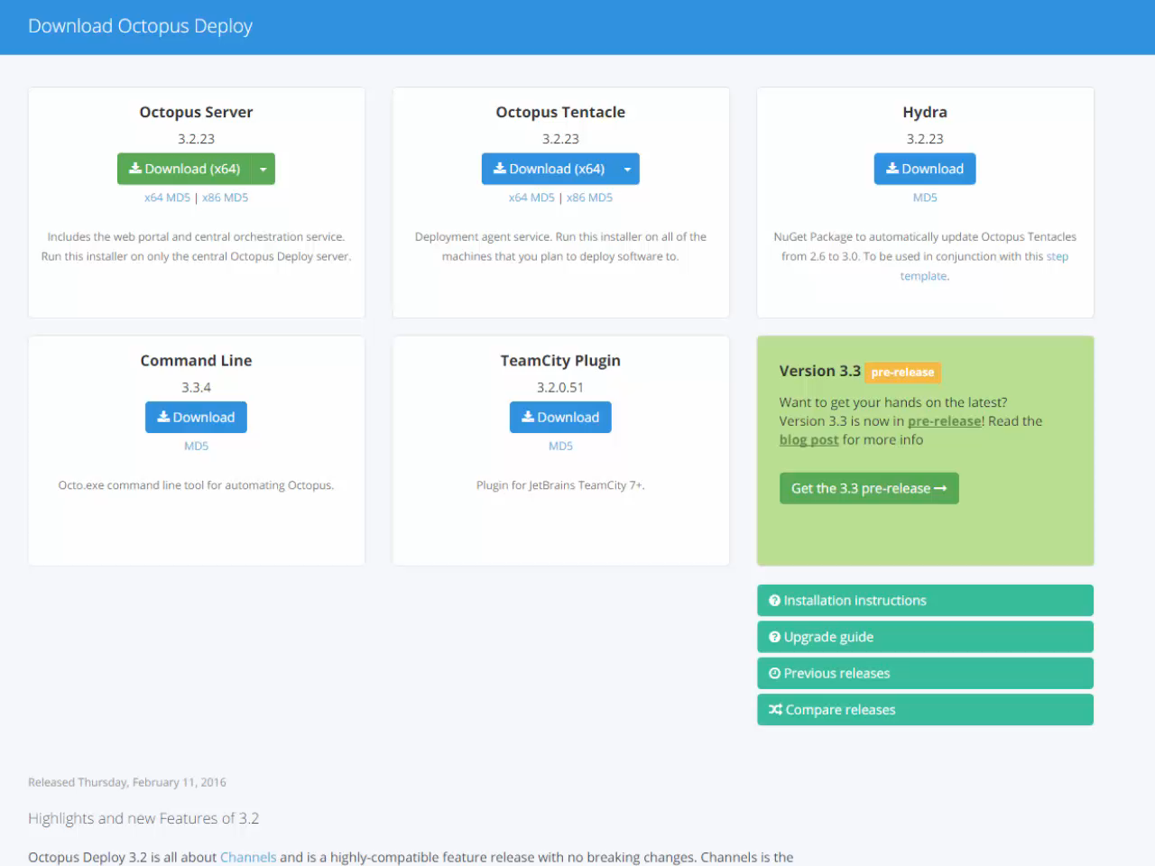
Video: Tentacle Install (09-01)

Slide 70
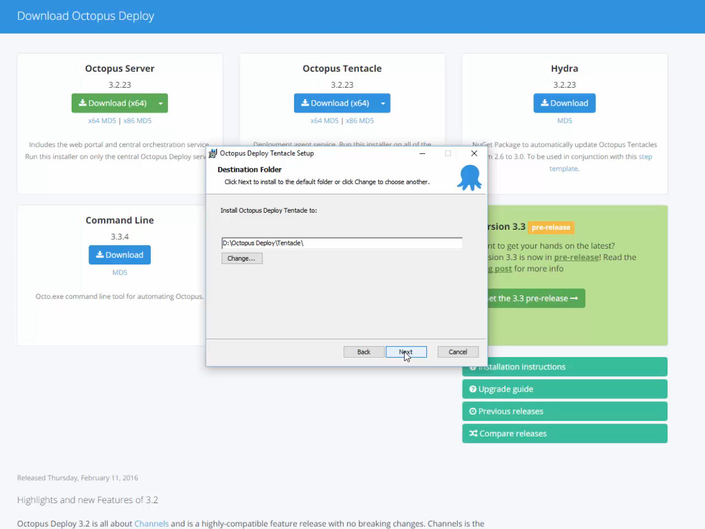
Video: Tentacle Install (09-02)

Slide 71
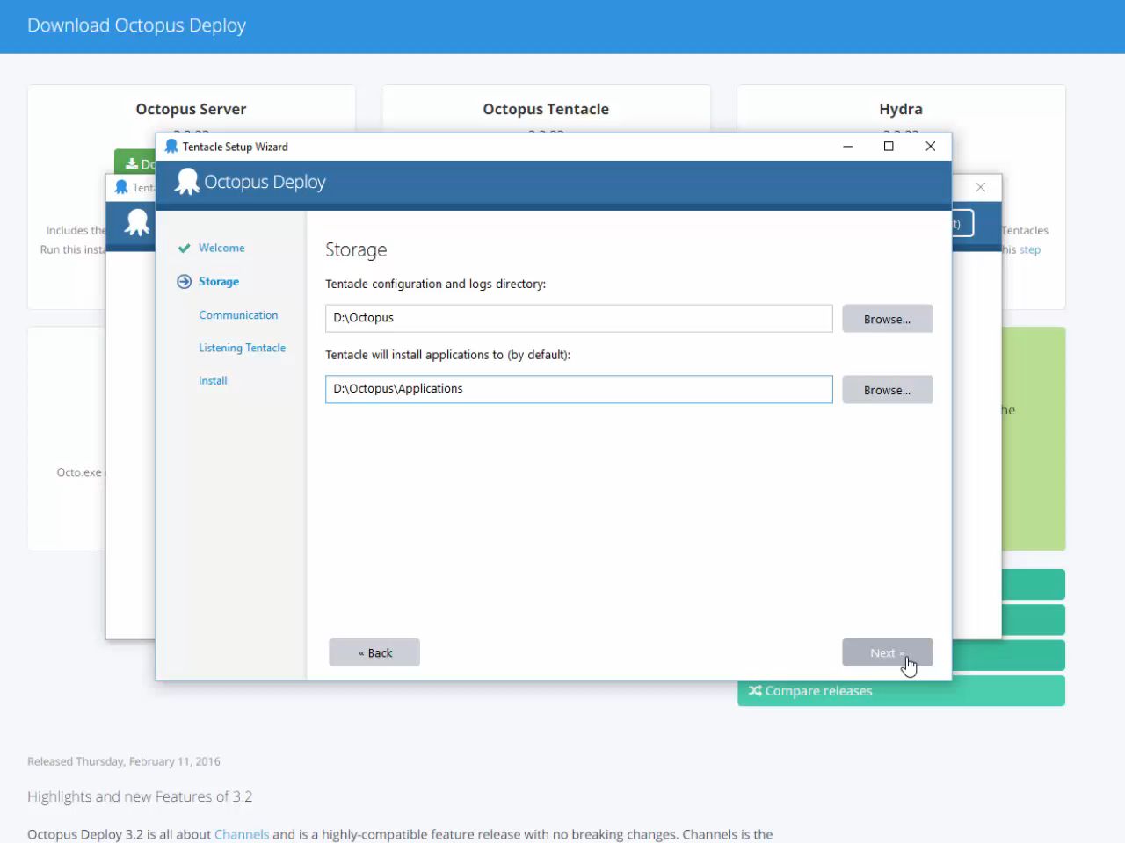
Video: Tentacle Install (09-03)

Slide 72
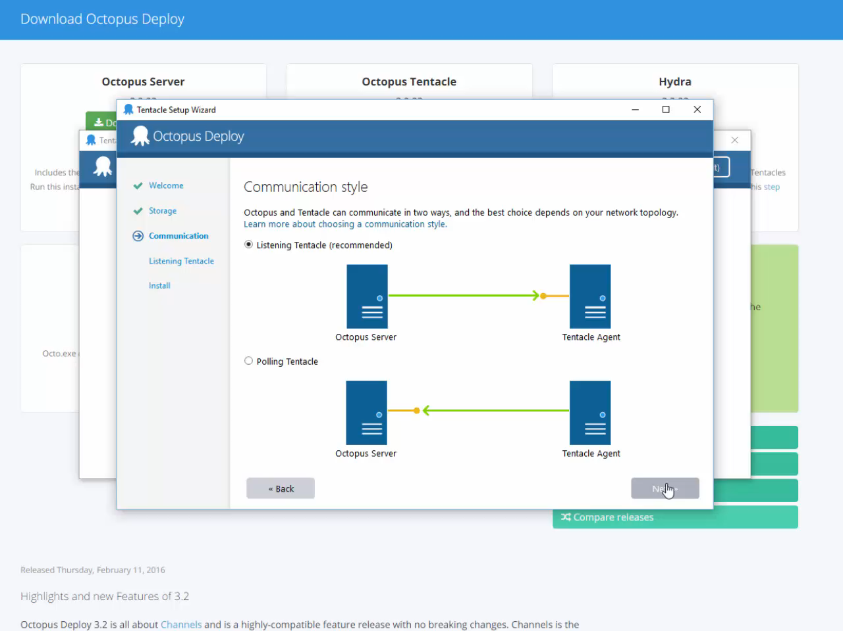
Video: Tentacle Install (09-04)

Slide 73
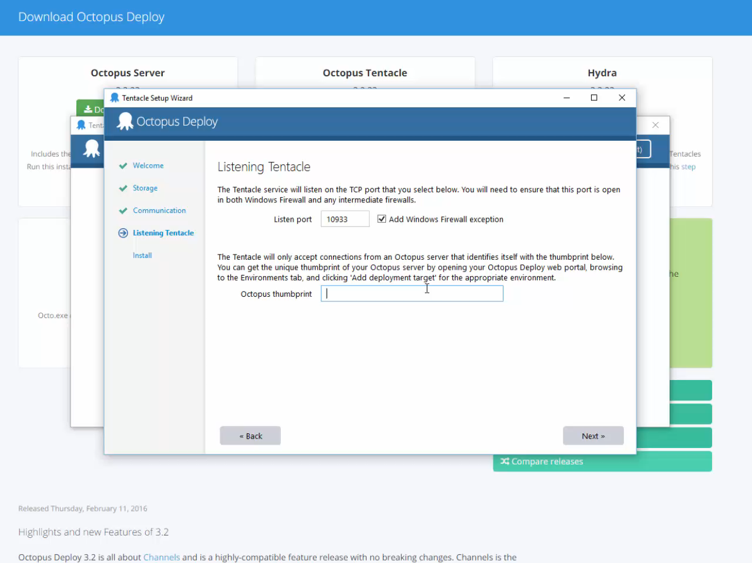
Video: Tentacle Install (09-05)

Slide 74
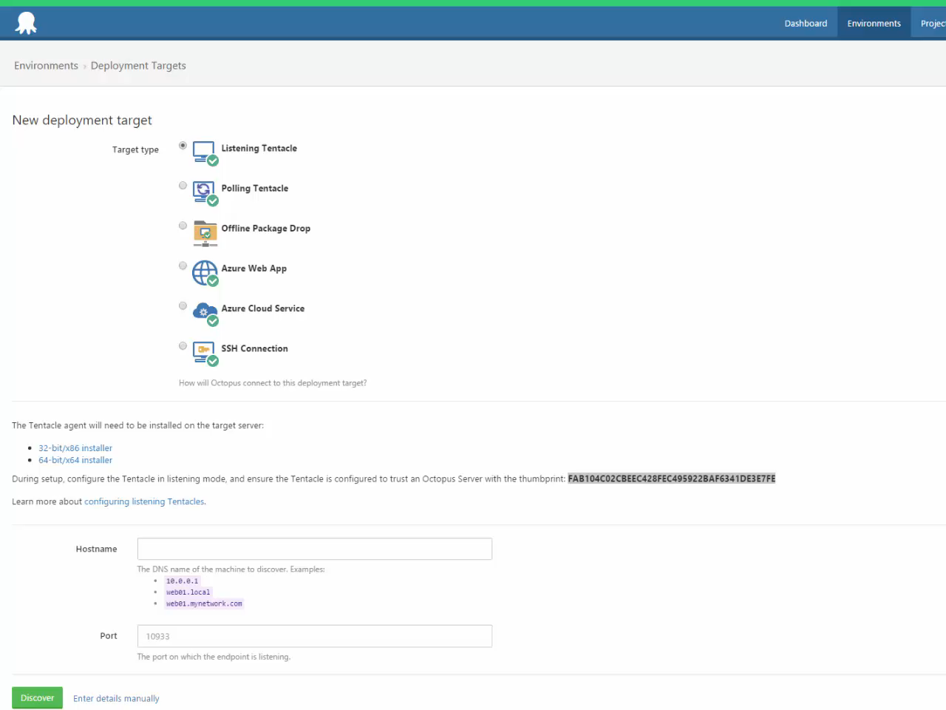
Video: Tentacle Install (09-06)

Slide 75
Oops, too much!
Notes:
Spun up a VM to serve as the production environment and added it
Updated the projects to add a .nuspec file
Added Octopack nuget to all packable projects
Added the Octopus extension to TeamCity
Updated TeamCity builds to run OctoPack & checked to make sure it was publishing nugets

Slide 76

Video: Recap (10-01)

Slide 77

Video: Recap (10-02)

Slide 78

Video: Recap (10-03)

Slide 79

Video: Recap (10-04)

Slide 80

Video: Recap (10-05)

Slide 81

Video: Recap (10-06)

Slide 82

Video: Recap (10-07)

Slide 83

Video: Recap (10-08)

Slide 84

Video: Recap (10-09)

Slide 85

Video: Recap (10-10)

Slide 86

Video: Recap (10-11)

Slide 87

Video: Recap (10-12)

Slide 88

Video: Recap (10-13)

Slide 89

Video: Recap (10-14)

Slide 90
RECAP

Slide 91
https://git.io/vgQcy
THANKS!

